Slide 1
ALMA – Looking back!
July –Aug 2022
Lambeth Conference
SB

Slide 2
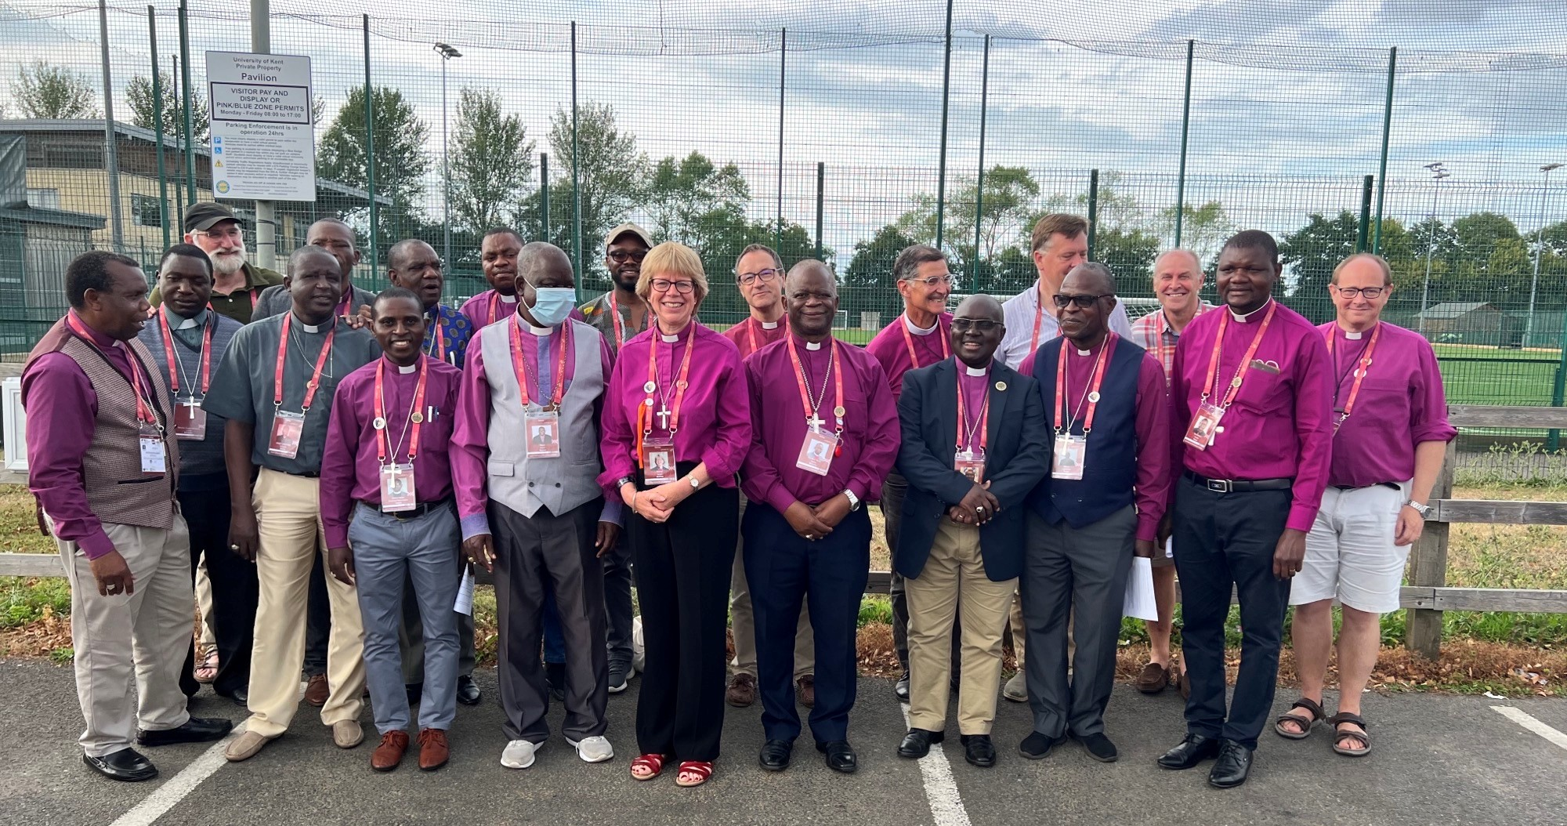

Slide 3
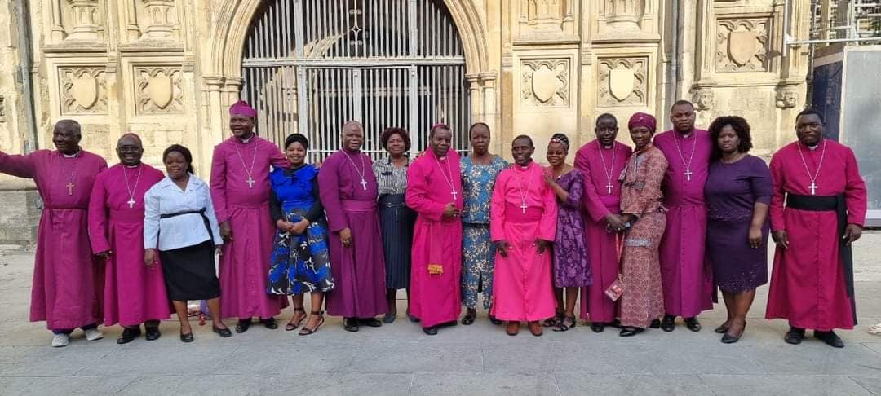

Slide 4
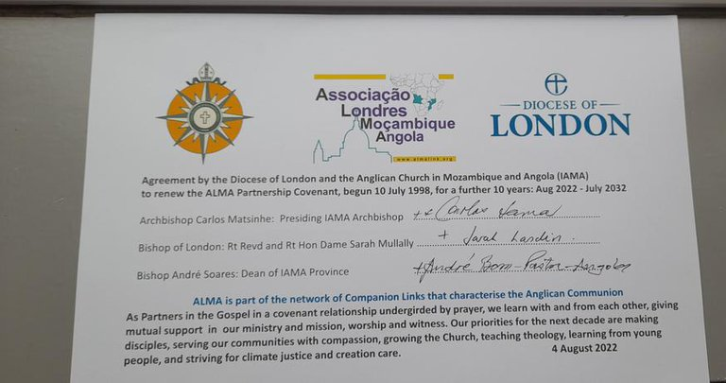

Slide 5
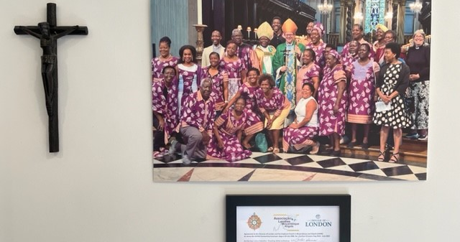

Slide 6
Sept – November 2022
New IAMA Bishops Enthroned

Slide 8
Nov 2022
Archbishop Justin
visits Maputo for
formal proclamation
of IAMA
And then to
Cabo Delgado
and IDPS

Slide 9
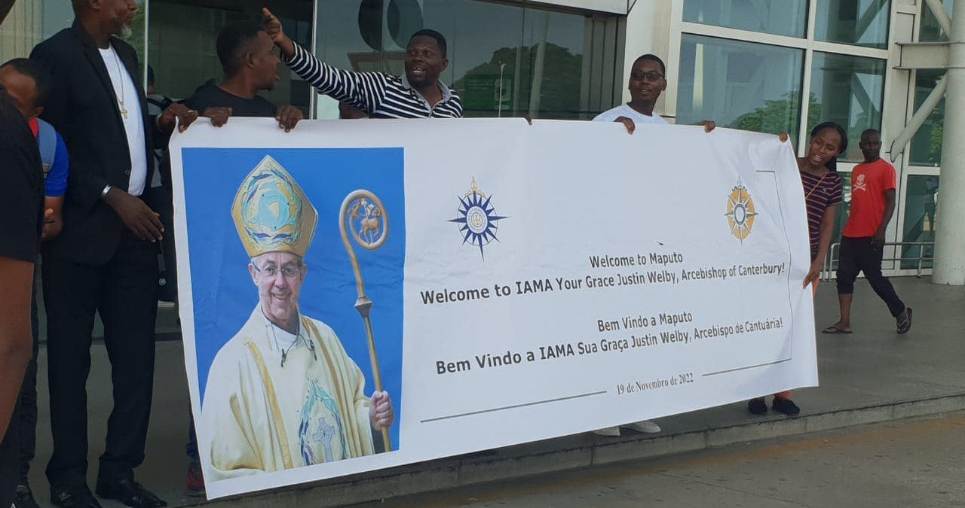

Slide 10
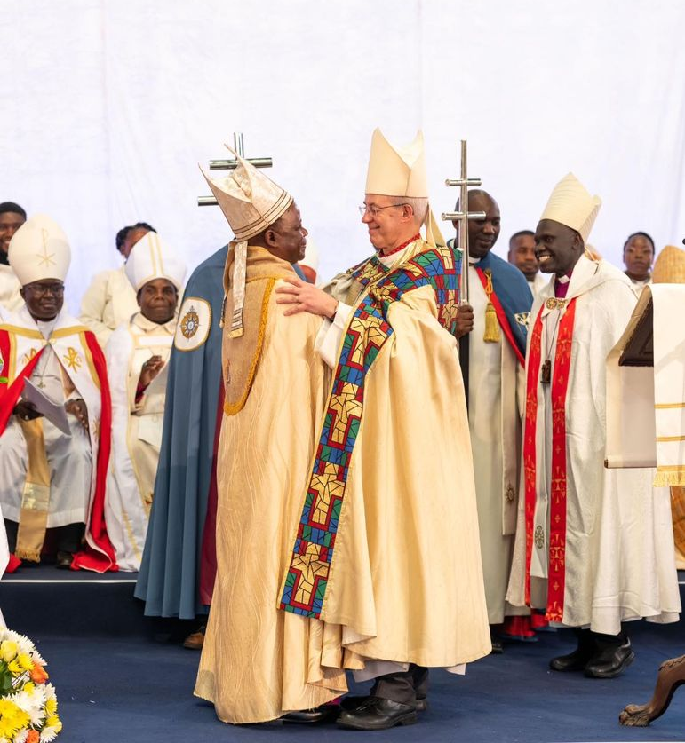

Slide 11
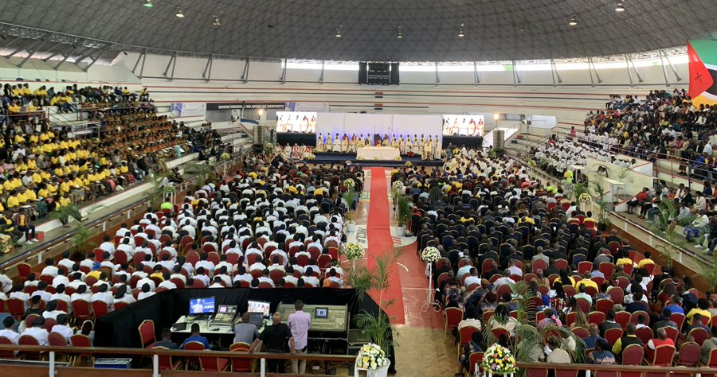

Slide 13
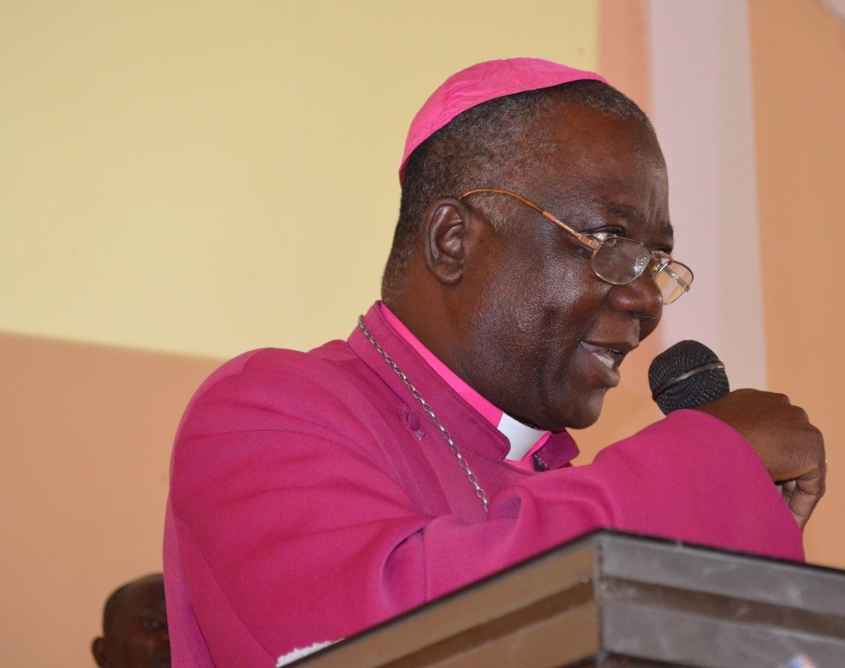
Retirement of Bishop André
Bishop of Angola 2003-2022

Slide 14
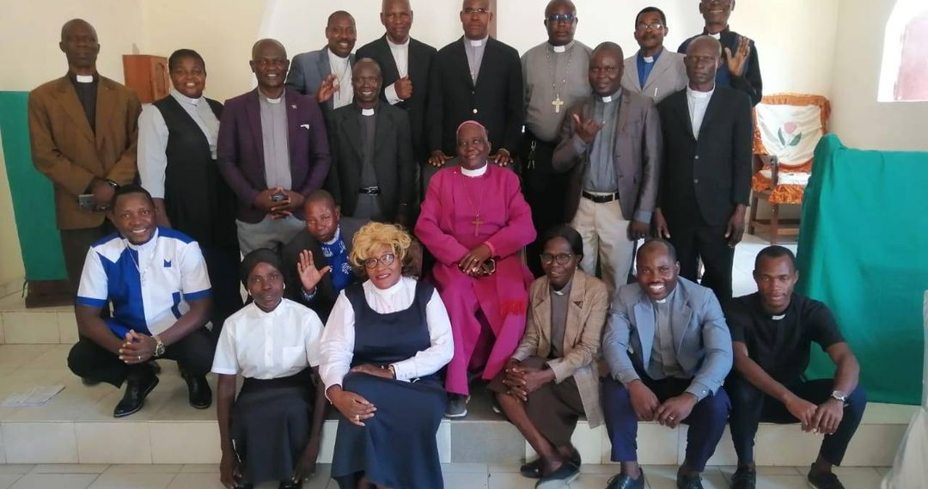

Slide 15
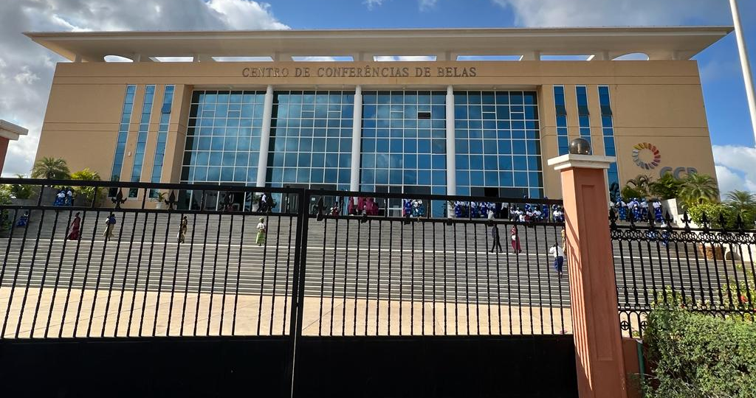

Slide 16
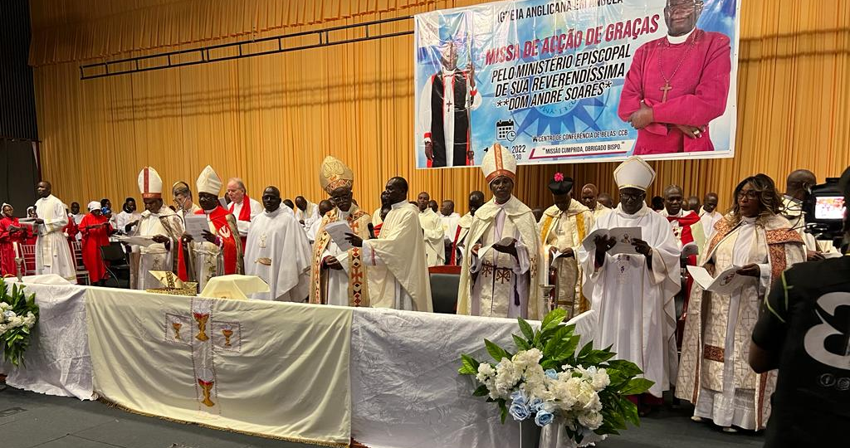

Slide 17
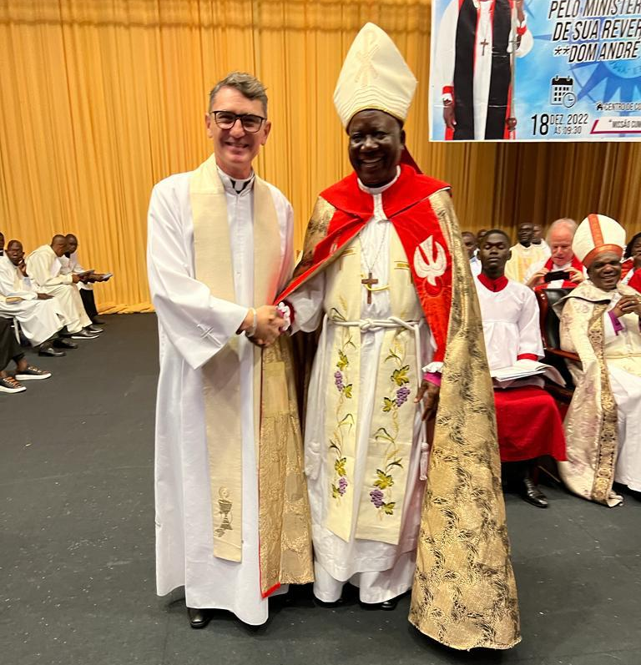
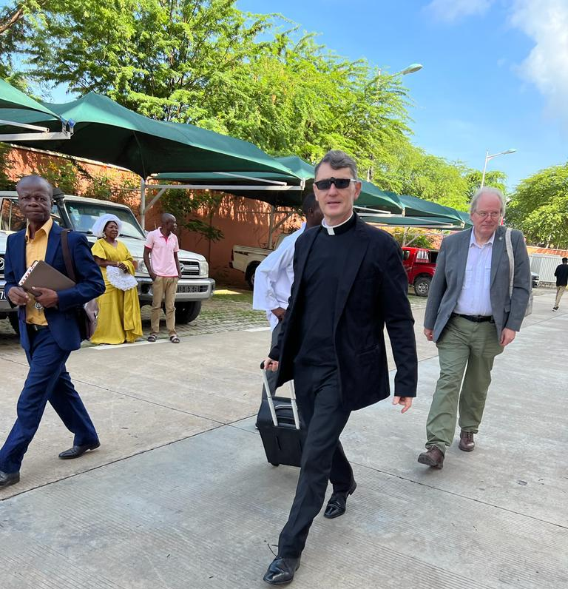

Slide 18
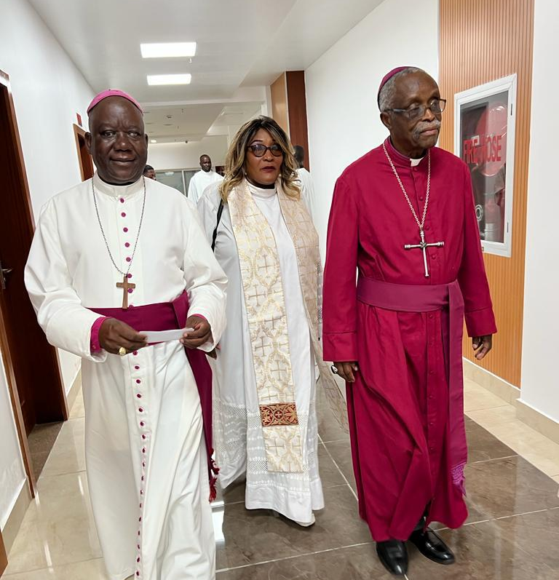
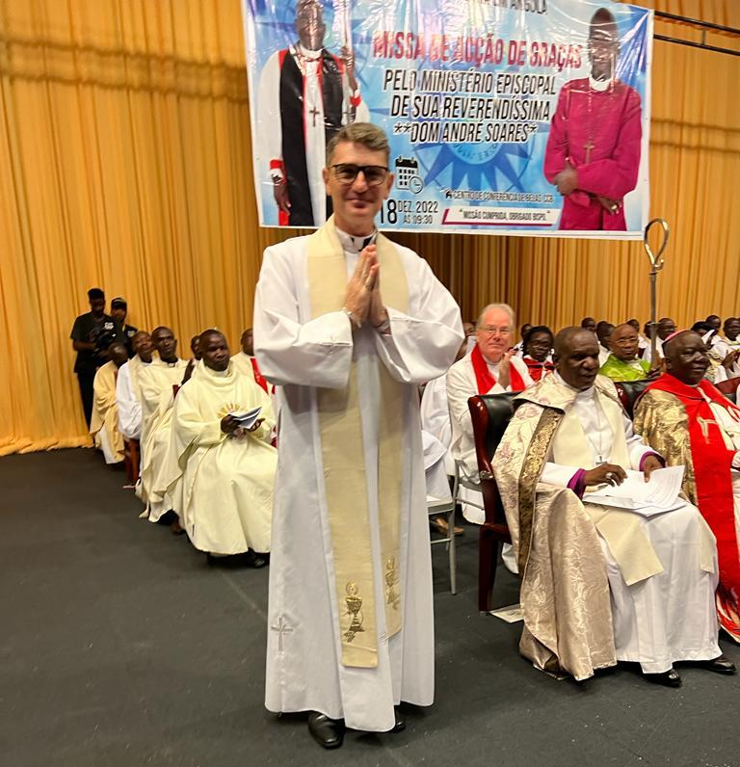

Slide 19
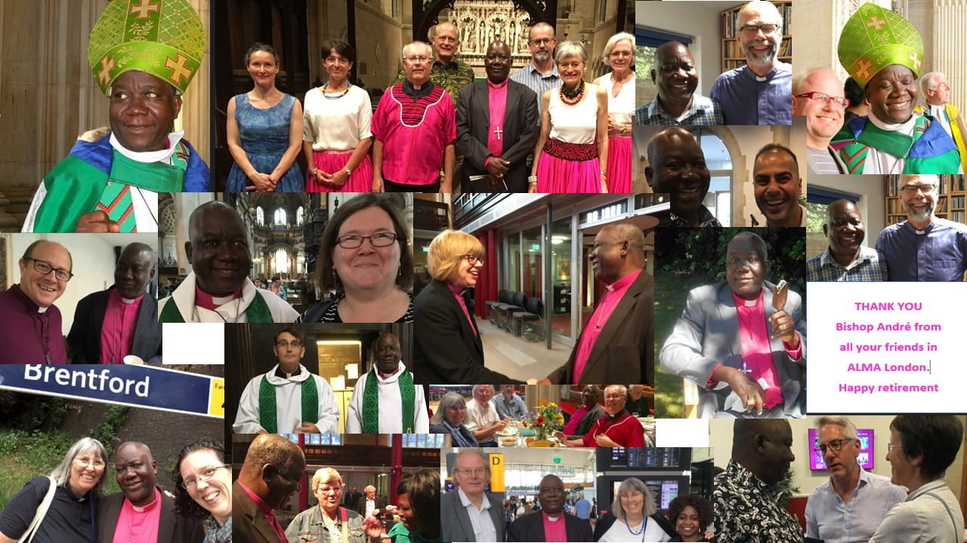

Slide 20
2023 June
Bishop Rob our London Bishop for ALMA
moves to be Chief Executive of the Church Urban Fund
His last ALMA Meeting was 20 June
Bishop Rob tweeted: One of the greatest joys of the past 8 years has been to work in partnership with @IAMA_Anglicana @ALMALondonD Last night the reinvigorated strategy group met for the first time @dioceseoflondon Prayers for @Lustherev as the new Chair @DomMatsinhe @bishopSarahM

Slide 21
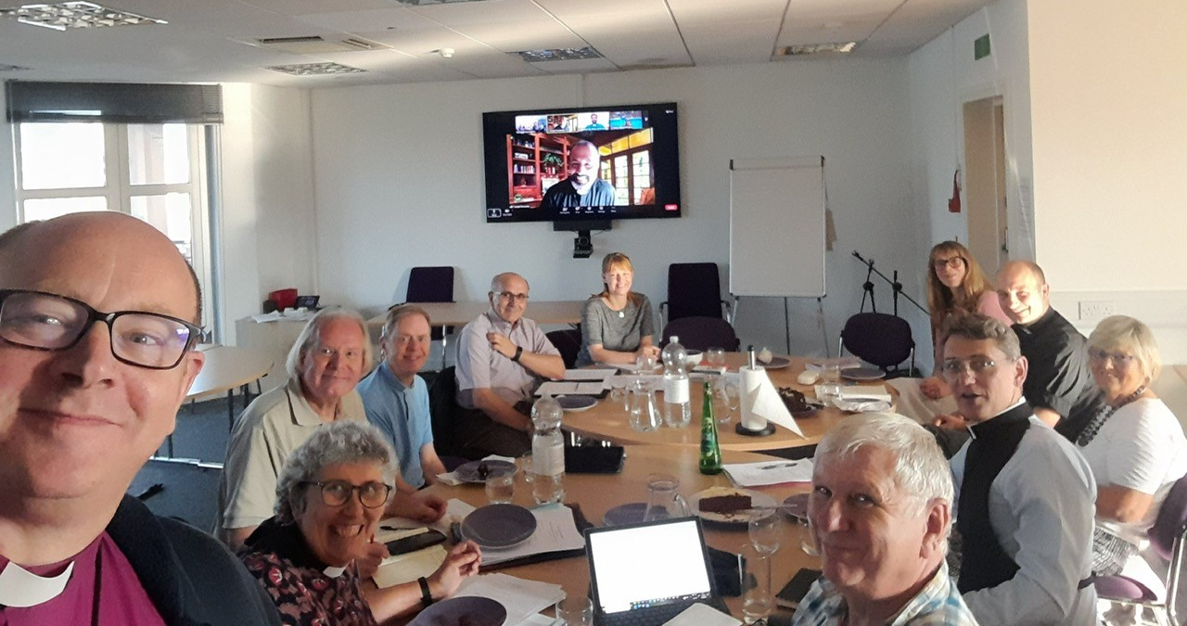

Slide 22
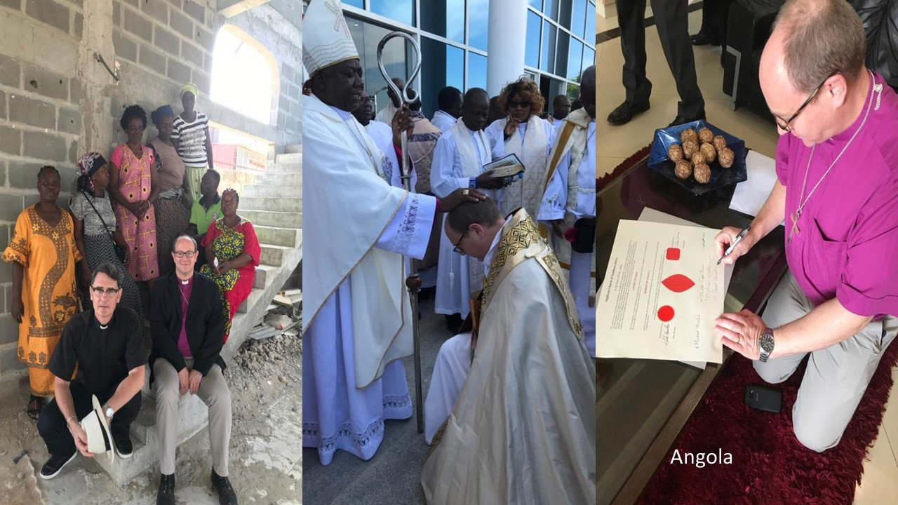

Slide 25
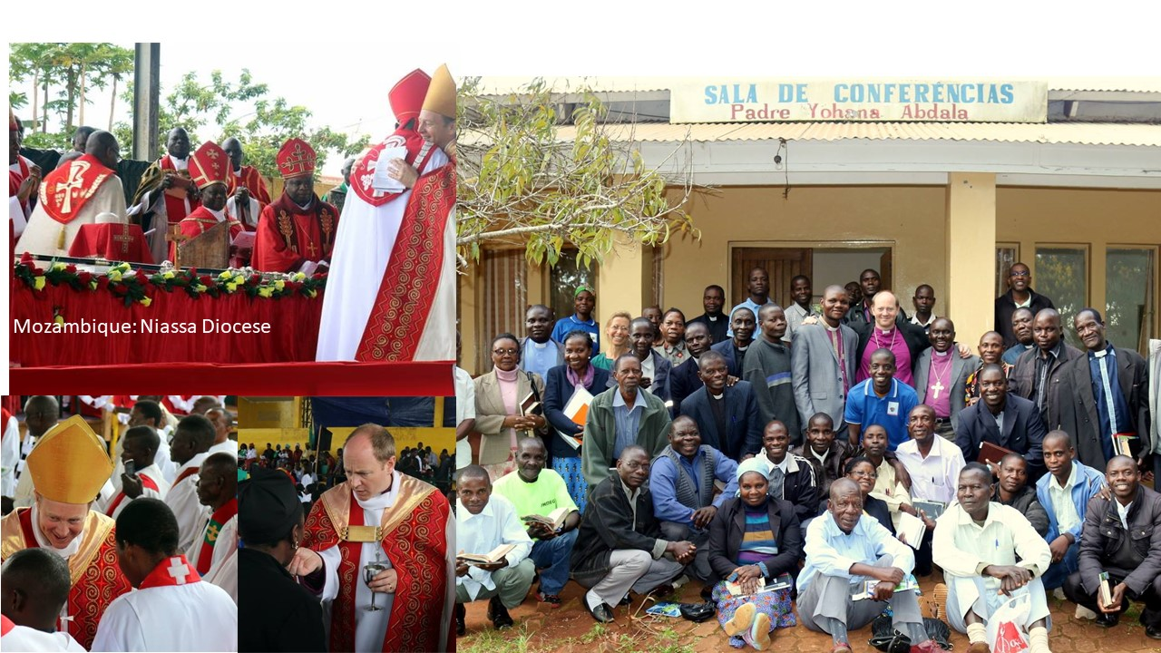

Slide 26
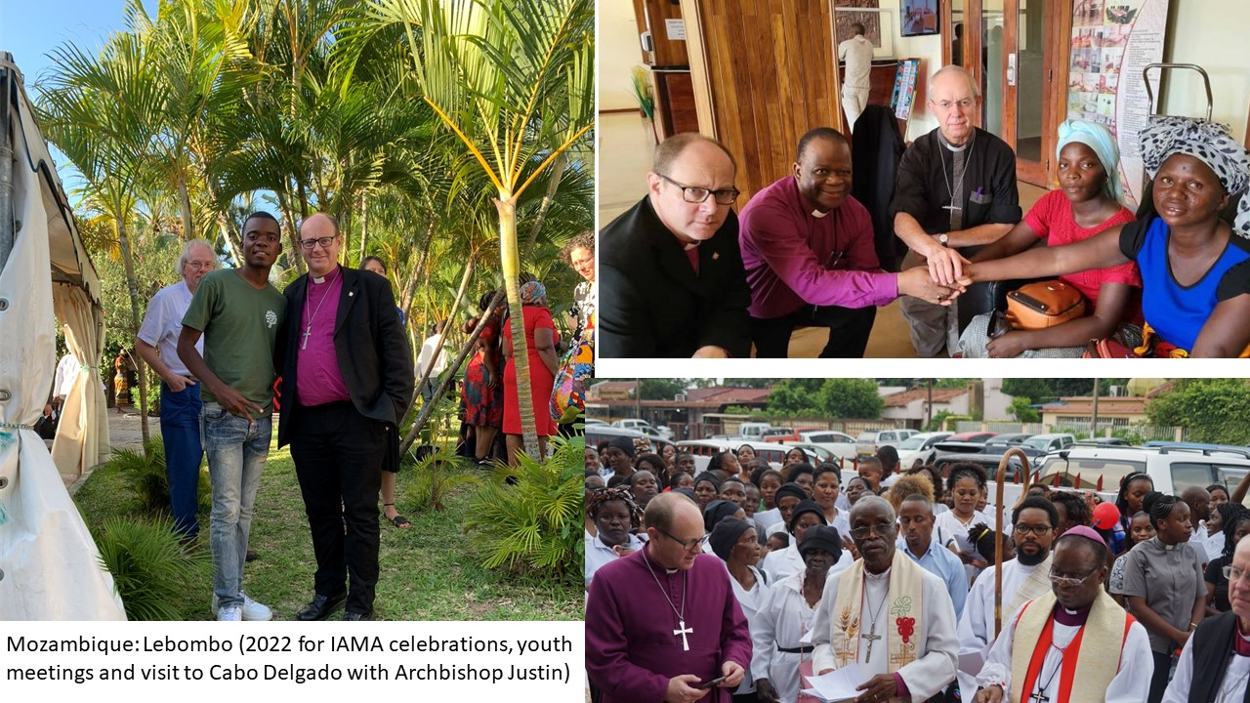

Slide 27
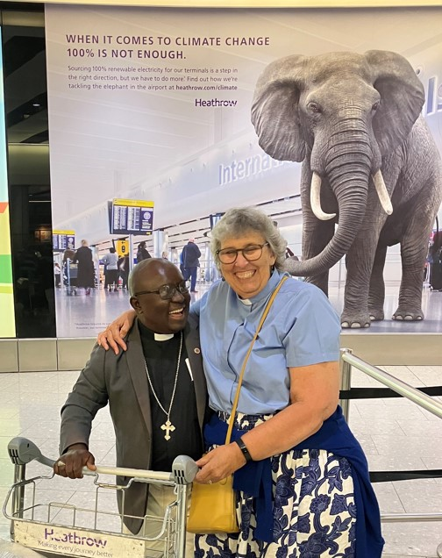
First ALMA partner visit for ALMA Sunday since 2019
Welcome Bishop Manuel

Slide 28
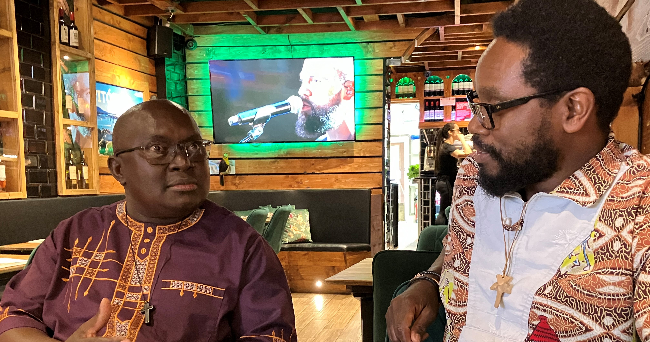

Slide 29
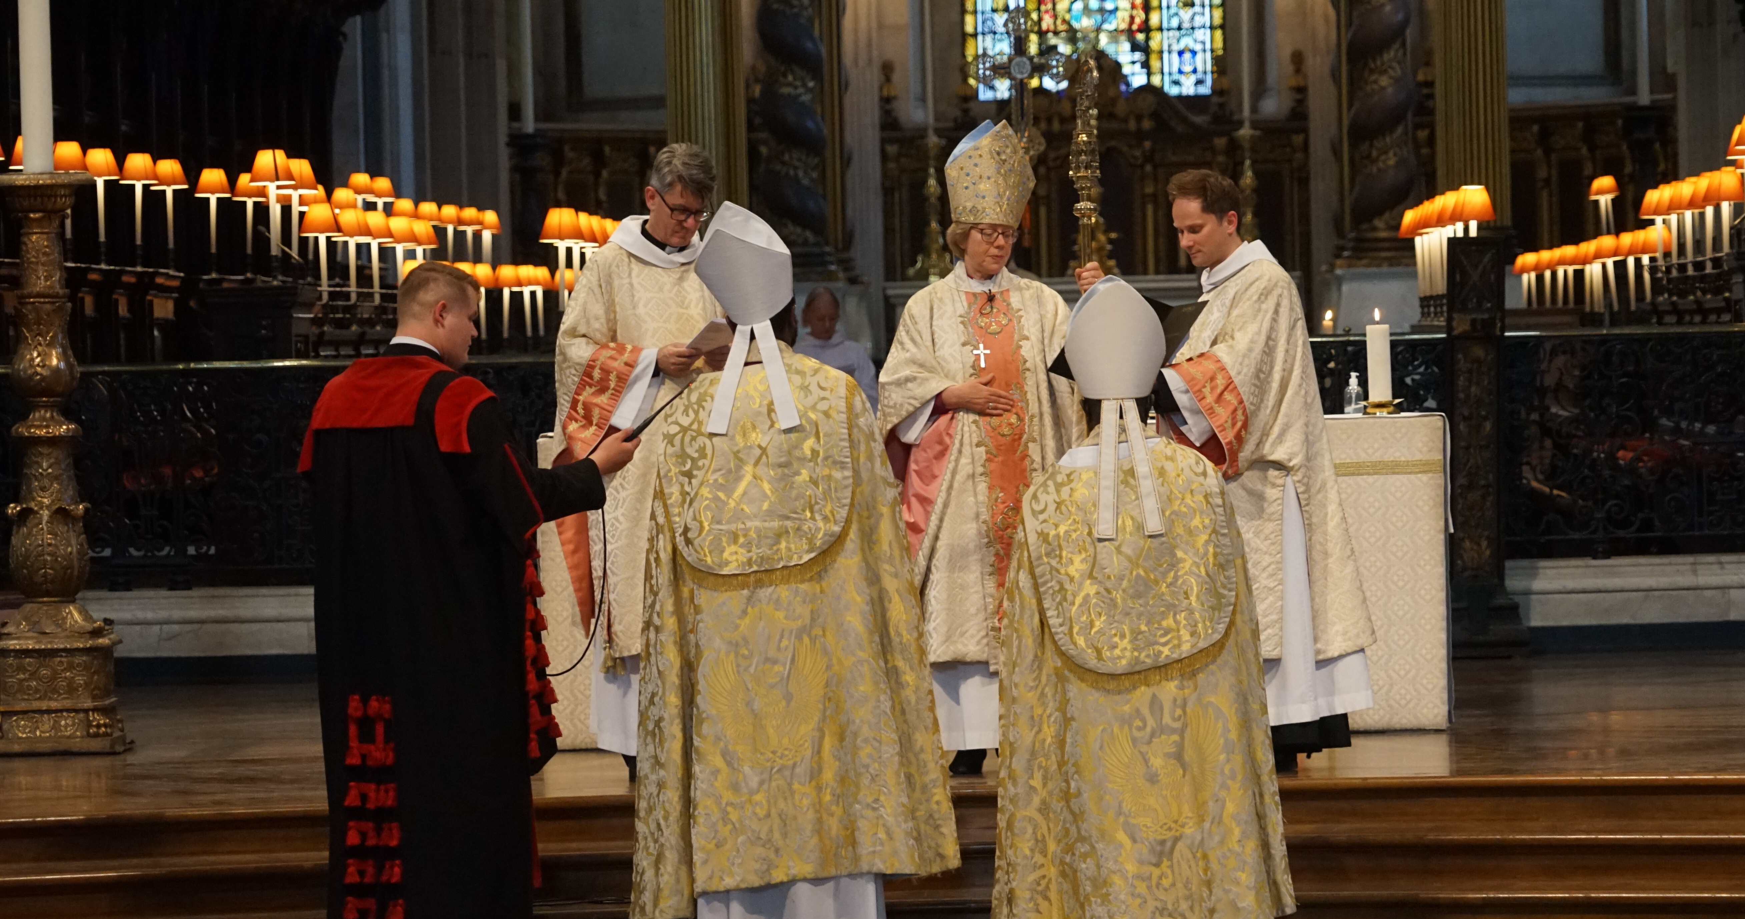

Slide 30
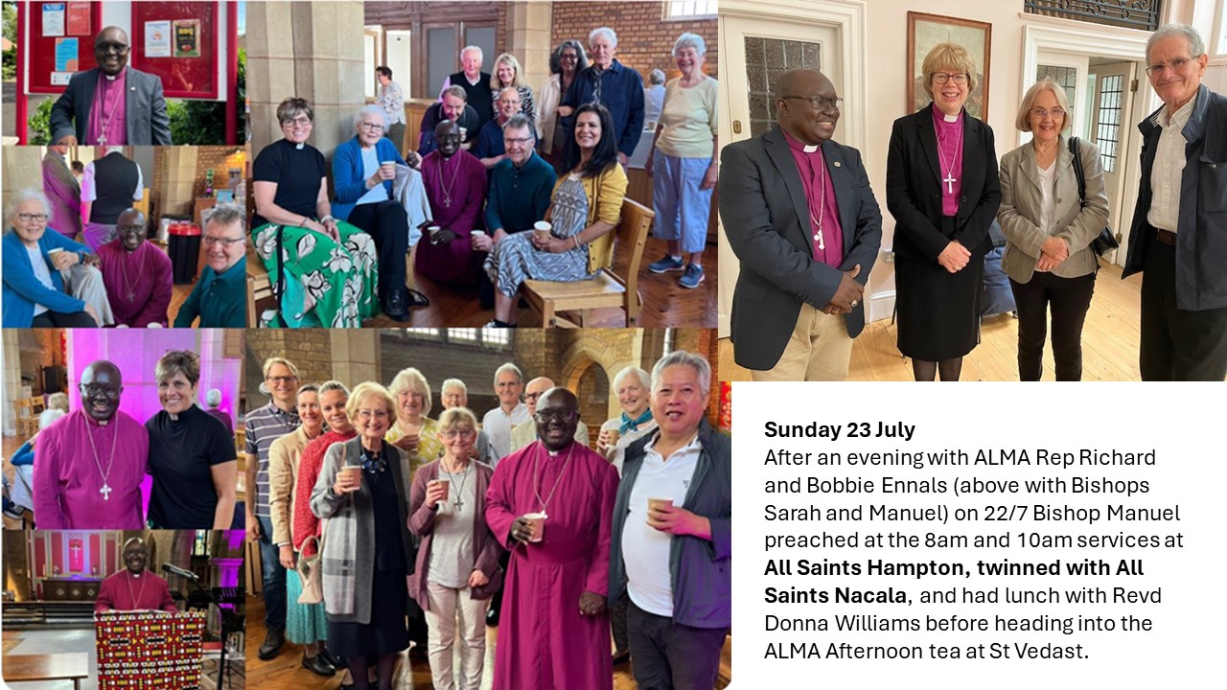

Slide 32
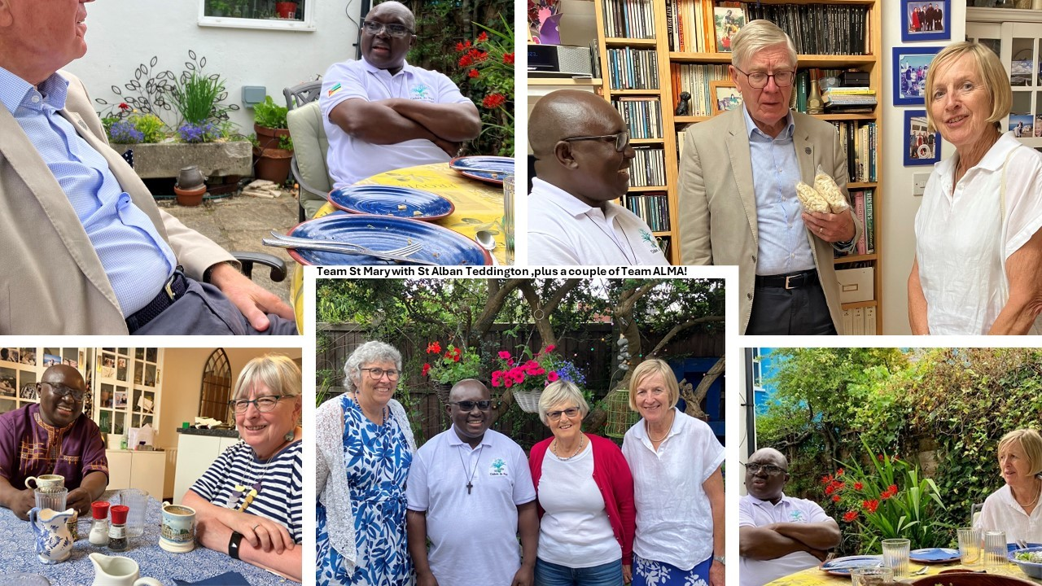

Slide 33
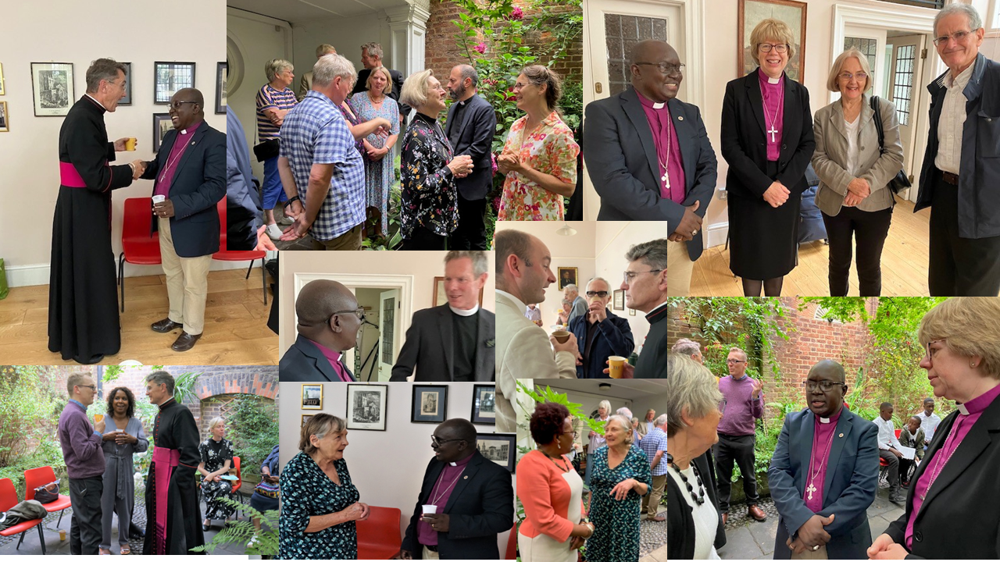

Slide 35
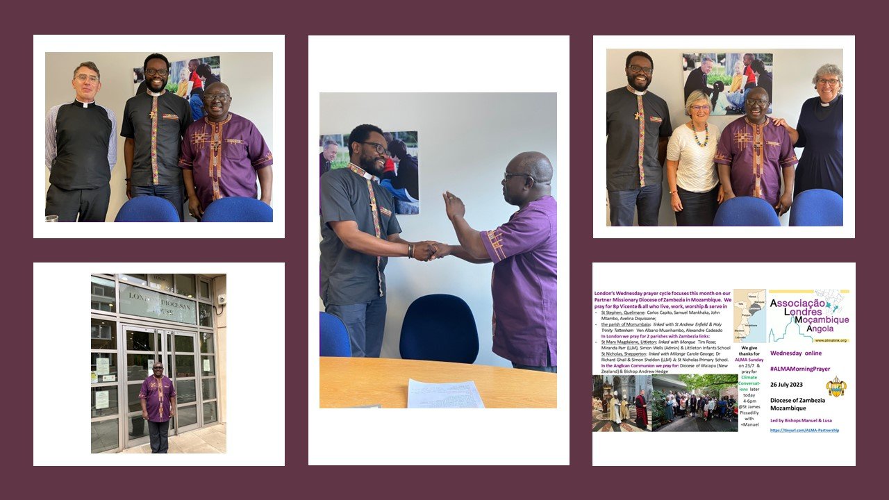

Slide 37
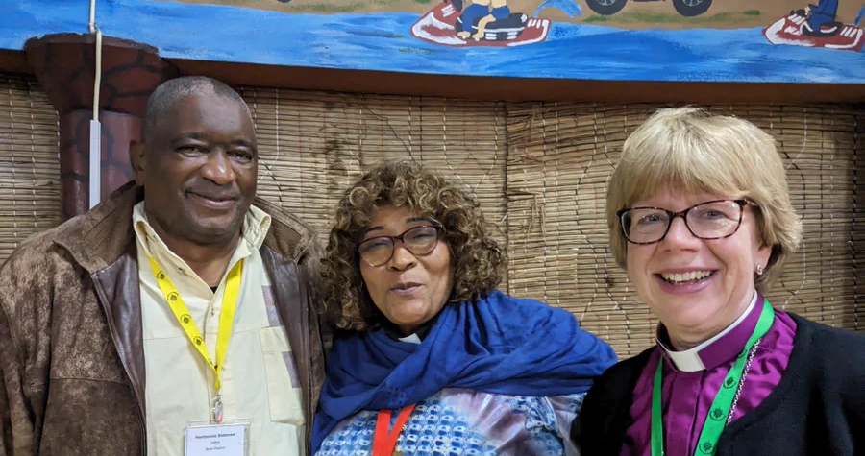

Slide 46
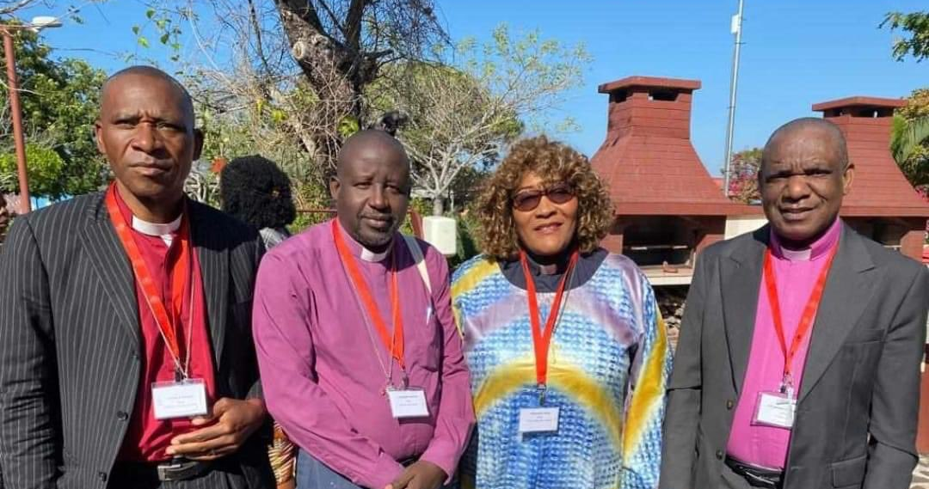

Slide 49
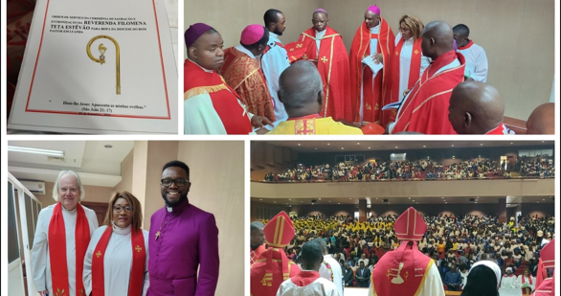

Slide 50
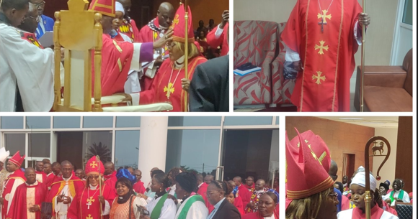

Slide 51
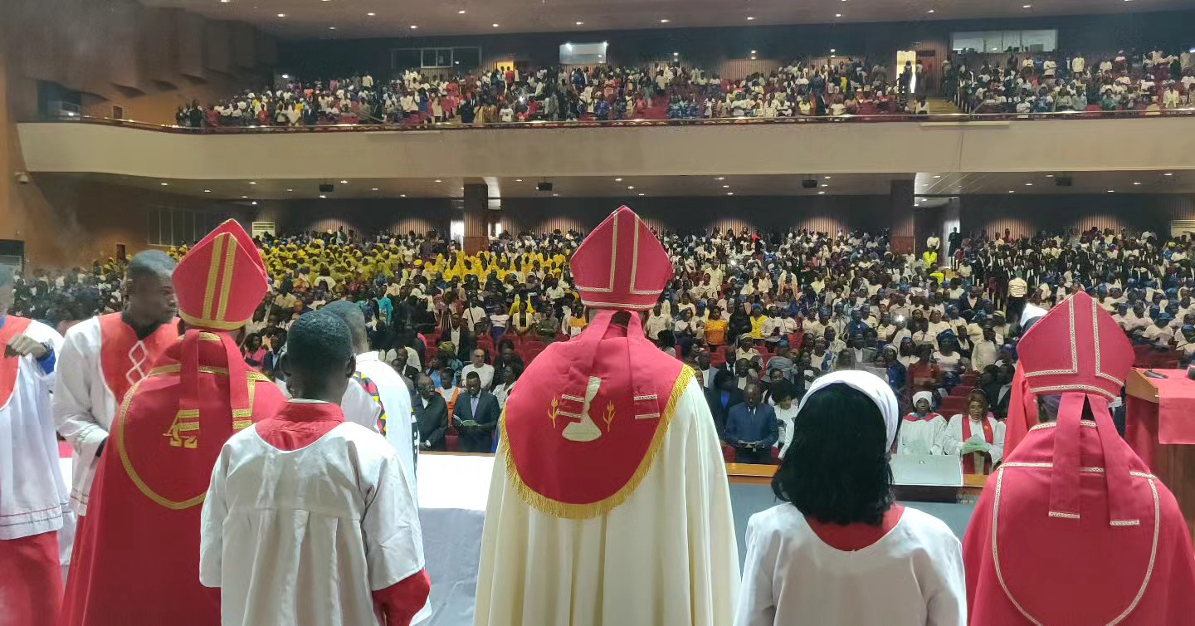

Slide 52
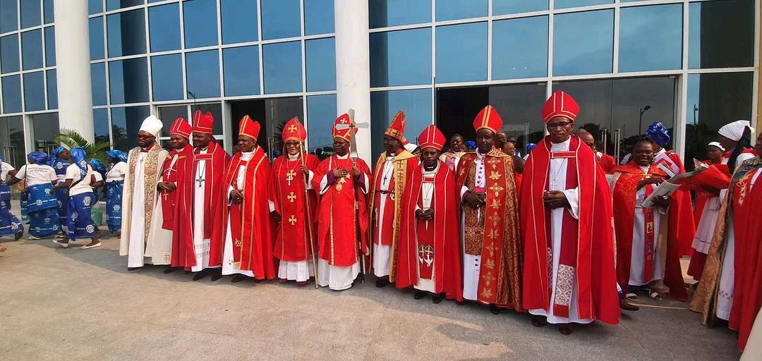

Slide 53
