Slide 1

Lent Appeal 2017
On behalf of ALMA
and our Diocesan Partners
in Angola and Mozambique
The Diocese of Angola
Notes:
Lent Appeal 2017
On behalf of ALMA London and our Diocesan Partners in Angola and Mozambique

Slide 2

Sowing Seeds for Tomorrow

Slide 3
The Diocese of Angola
has a massive need to provide more school places
Notes:
The Diocese of Angola has a massive need to provide more school places

Slide 4
It is increasing the number of classrooms in schools:
to meet government requirements
to ensure a Christian presence
to offer more young people an education to
Notes:
The project is to double the size of church schools so they have eight classrooms instead of four. With hundreds of children waiting for a place at a school, this increase in size will not only meet new government requirements which in turn will ensure a continuing Christian presence, but offer even more young people the chance of an education.

Slide 5

The Anglican Church in Angola
Has 12 schools attached to parish churches.
most have been built with help from
ALMA and parish churches in London.
all the church schools are very popular; demand for places is extremely high.
Notes:
The Anglican Church in Angola
has twelve schools attached to parish churches.
most have been built with help from ALMA and parish churches in London.
all the church schools are very popular
demand for places is extremely high.

Slide 6
Angolan Church Schools
have two to three separate shifts a day.
educate several hundred children.
are now in urgent need of expansion and upgrading to provide more classrooms and better facilities.
Notes:
Angolan Church Schools
have two to three separate shifts a day,
educate several hundred children.
many now in urgent need of expansion and upgrading to provide more classrooms and better facilities.

Slide 7
ALMA are already supporting school building projects in:
Notes:
ALMA are already supporting school building projects in three places …

Slide 8
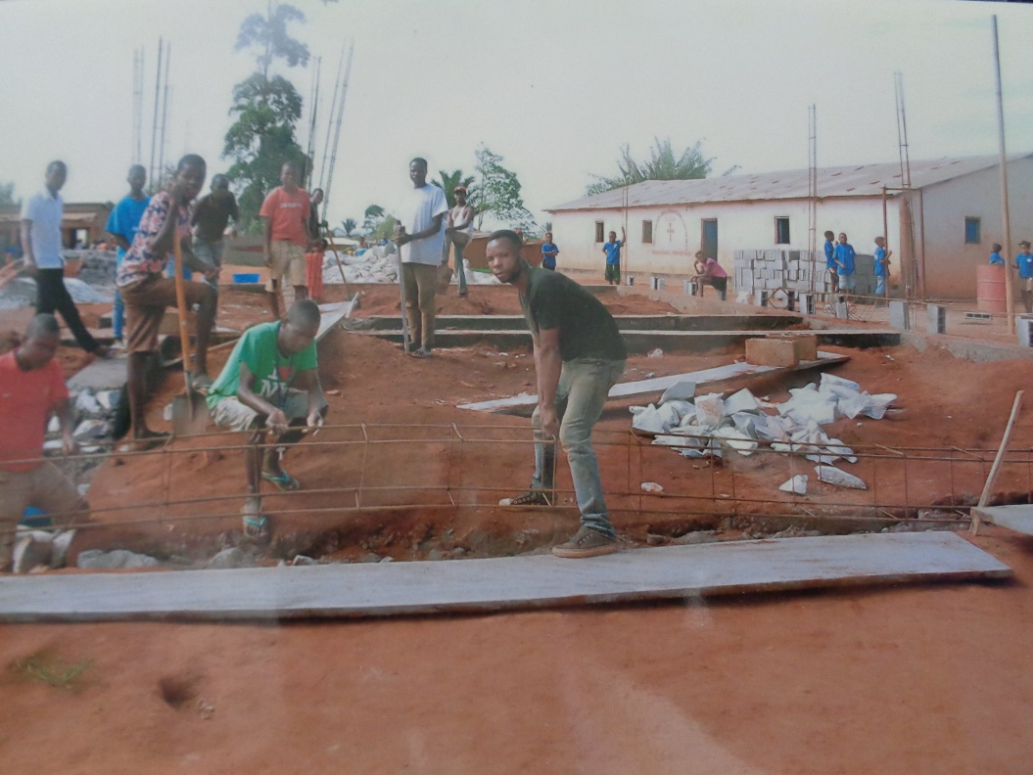
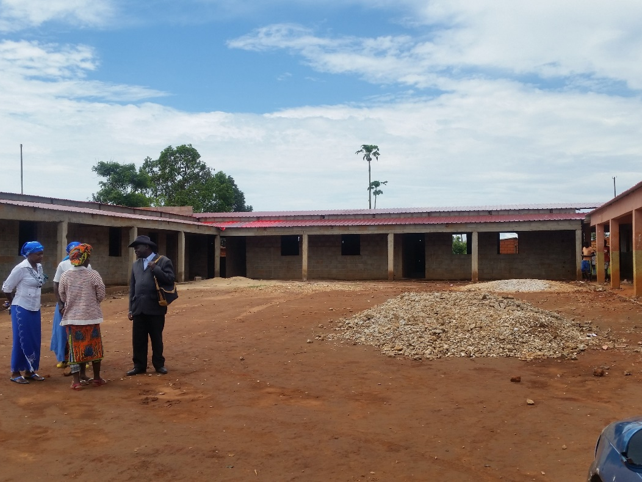
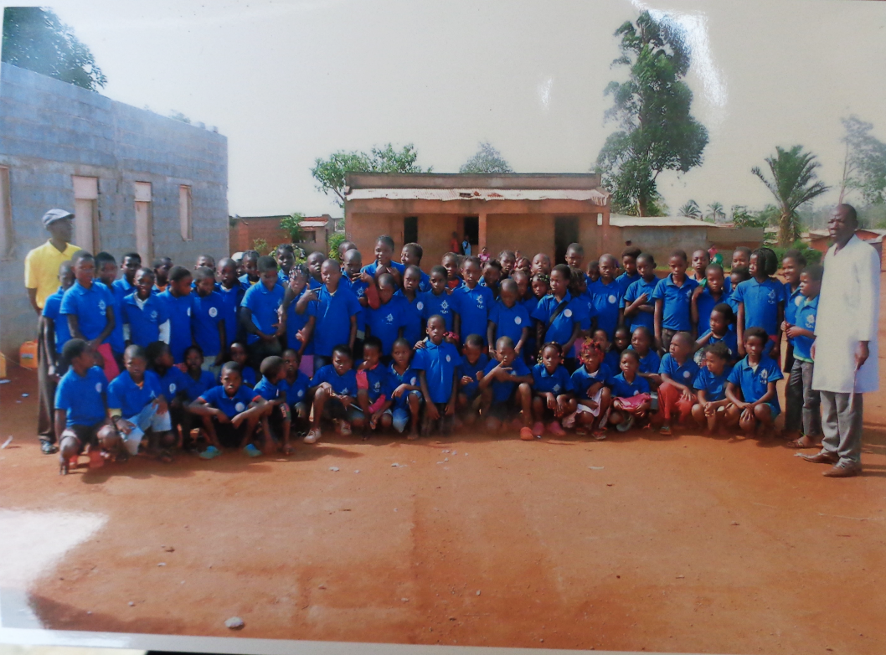
Negage
Notes:
Negage

Slide 9
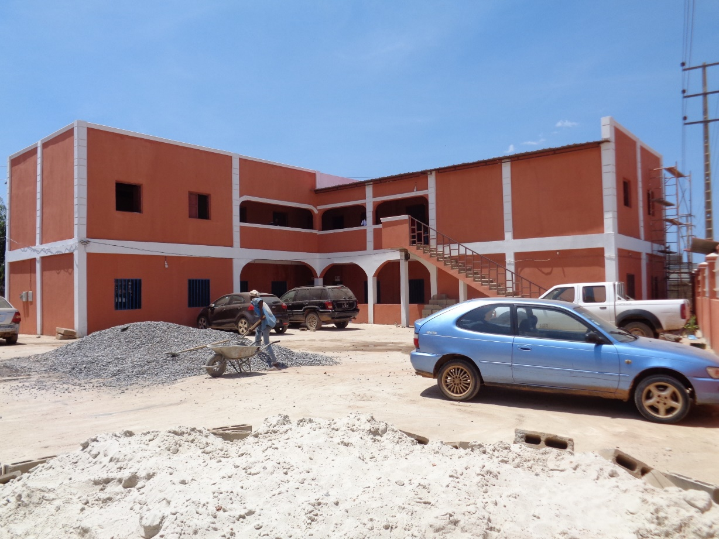
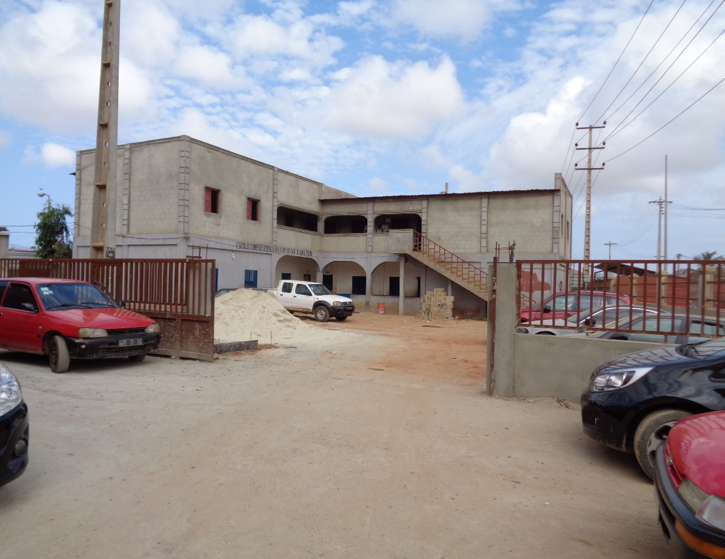
Luanda
During
After
Notes:
Luanda

Slide 10
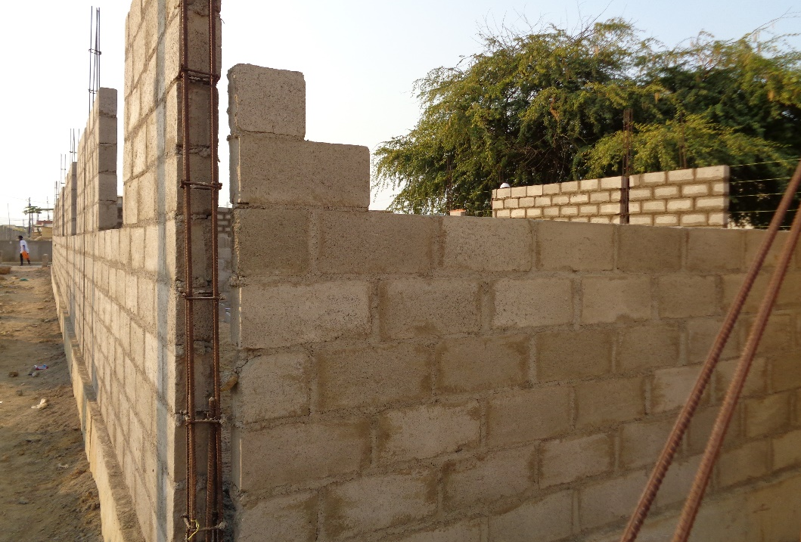
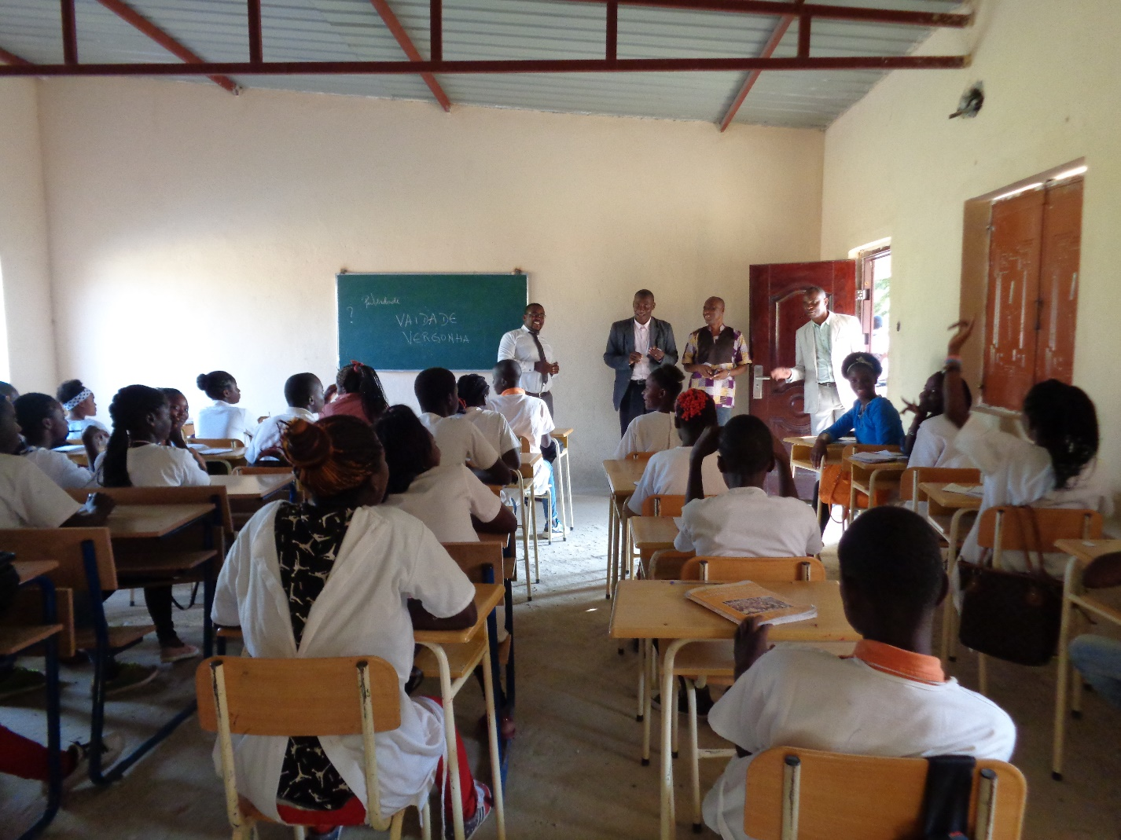
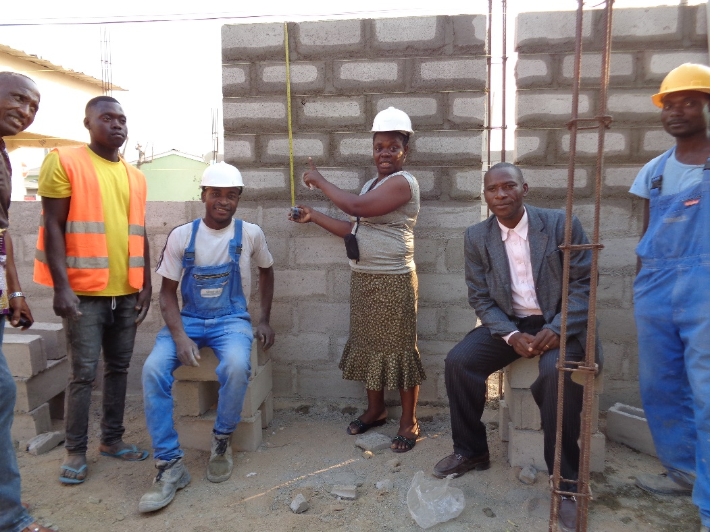
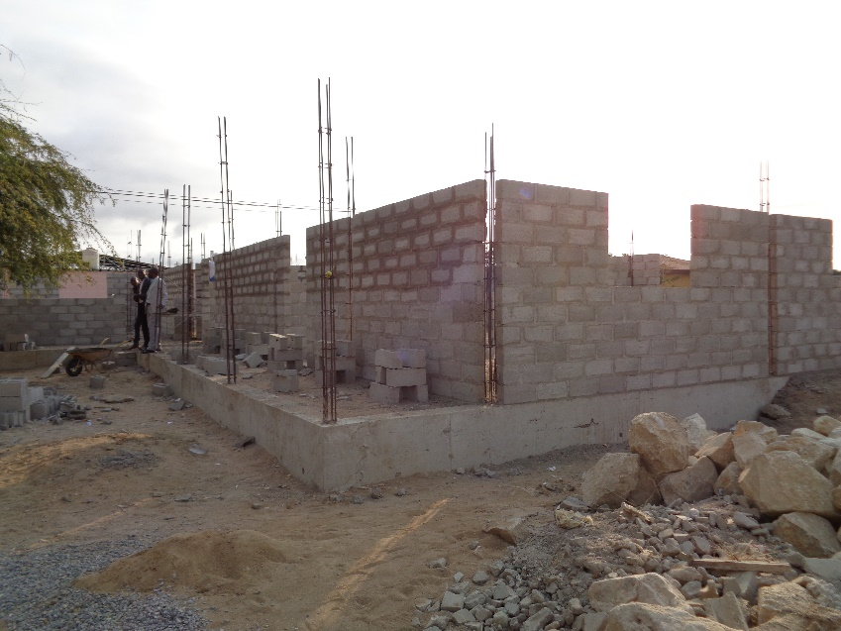
Benguela
Notes:
Benguela

Slide 11
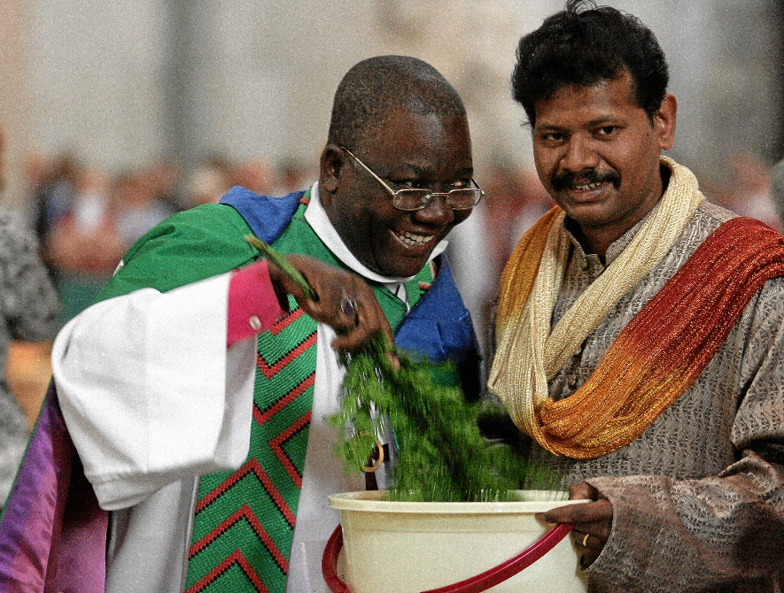
Bishop Andre says:
                "Expanding and upgrading church schools is one of of my top priorities”.
“Education is a vital part of our mission and outreach. The more school places we provide, the more children and communities we will be able to support."
Notes:
Bishop Andre (the Bishop for Angola) says:
"Expanding and upgrading church schools is one of my top priorities. Education is a vital part of our mission and outreach. The more school places we provide, the more children and communities we will be able to support."

Slide 12
Please join us as we journey with our vibrant and optimistic partners in Christ during Lent 2017 and support them in
Sowing Seeds for Tomorrow
For more information visit
www.london.anglican.org/lentappeal
Notes:
Please support the 2017 Lent Appeal on behalf of ALMA and our Diocesan Partners in Angola and Mozambique.

