Slide 1
Lent Appeal 2017
On behalf of ALMA
and our Diocesan Partners
in Angola and Mozambique
The Diocese of Lebombo
Notes:
Lent Appeal 2017
On behalf of ALMA London and our Diocesan Partners in Angola and Mozambique

Slide 2
Sowing Seeds for Tomorrow
Notes:
The Diocese of Lebombo

Slide 3
The Diocese of Lebombo
a significant project for an accredited seminary to train the next generation of church leaders.
Notes:
The Diocese of Lebombo is initiating a significant project to create a new accredited seminary outside Maputo to train the next generation of church leaders.

Slide 4
Background
Seminary is currently at main Diocesan centre in Maputo
Shared with the local parish and all Diocesan administrative staff
BUT
Notes:
The seminary for the Diocese of Lebombo is currently at the main Diocesan Centre in Maputo – a small site shared with the local parish and all Diocesan administrative staff
BUT …

Slide 5
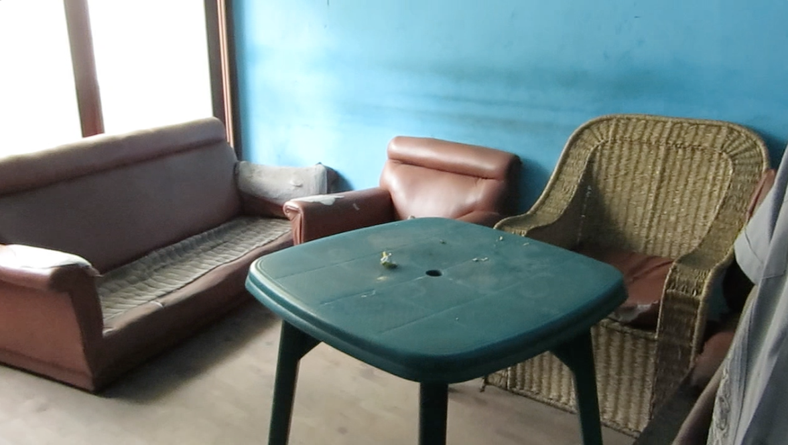
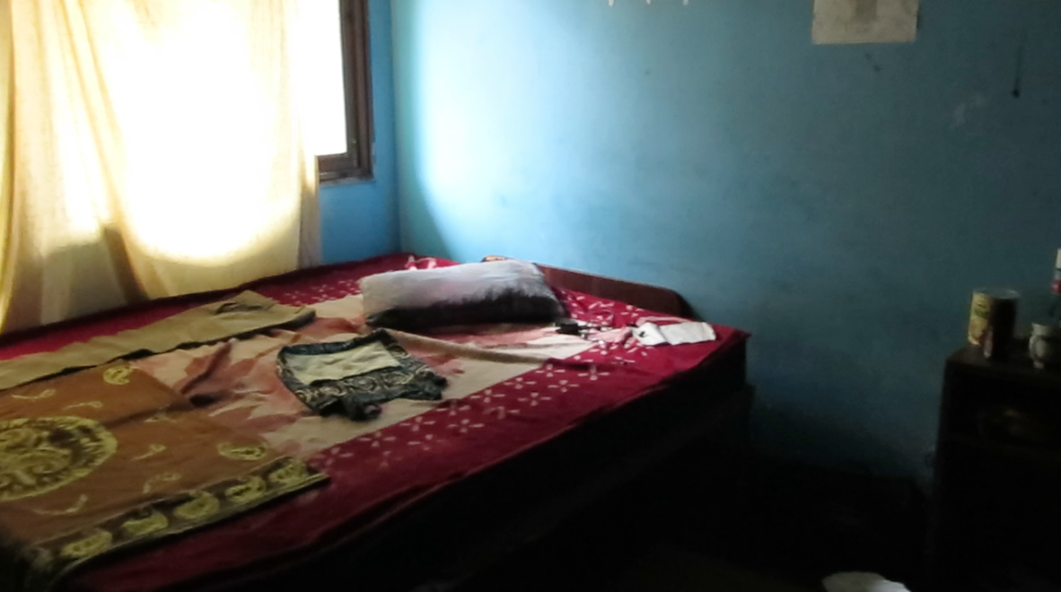
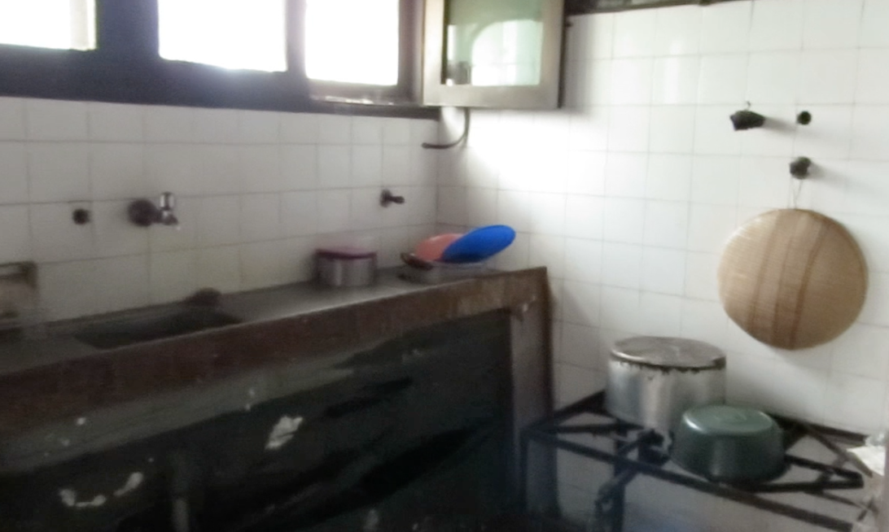
It’s in need of repair and restoration!
Notes:
It’s in much need of repair and restoration.

Slide 6
Currently
14 students studying - including two women
8 teachers, all volunteers, including two Bishops and four priests
Able to offer a certificate in theology
Notes:
Currently
There are 14 students studying at the seminary including two women
There are 8 teachers, all volunteers, including two Bishops and four priests
They are currently able to offer a certificate in theology

Slide 7
Vision
Main centre for clergy training for Lusophone Africa
Separate site for all students to reside
Improved facilities that promote education and learning
Upgrade from the certificate to a diploma
Notes:
Vision
To be the main centre for clergy training for Lusophone Africa
To have a separate site for seminary where all students could reside
To have improved facilities that promote education and learning
To upgrade from the certificate to a diploma

Slide 8
Progress
Syllabus checked to become diploma course
Land has been found ……….
Notes:
Progress
The Diocese is already having the syllabus checked by an external body to get it accredited at a diploma course
Land has been found.

Slide 9
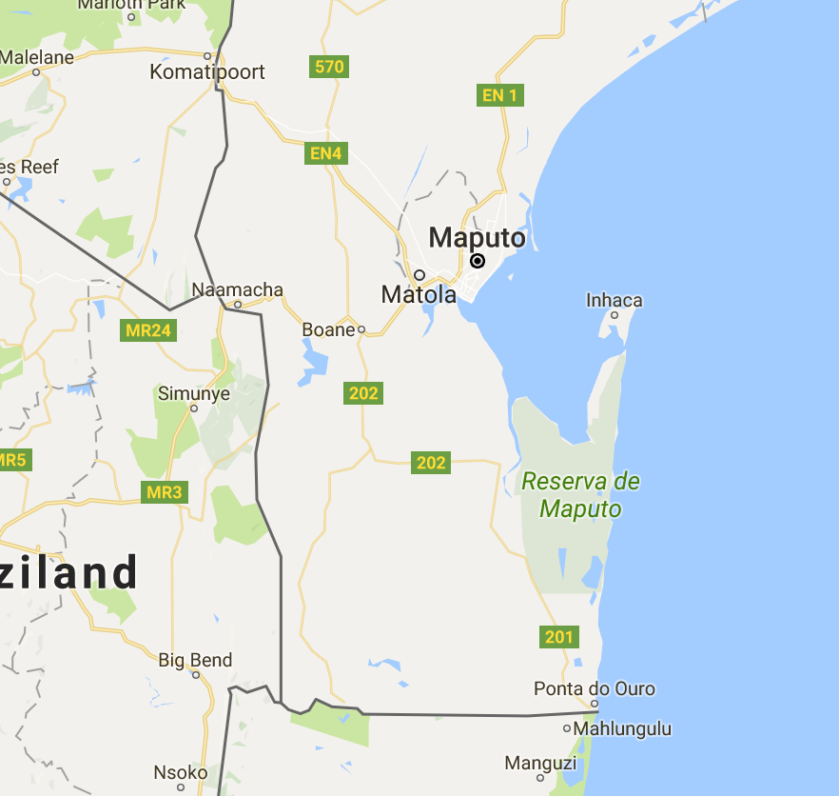
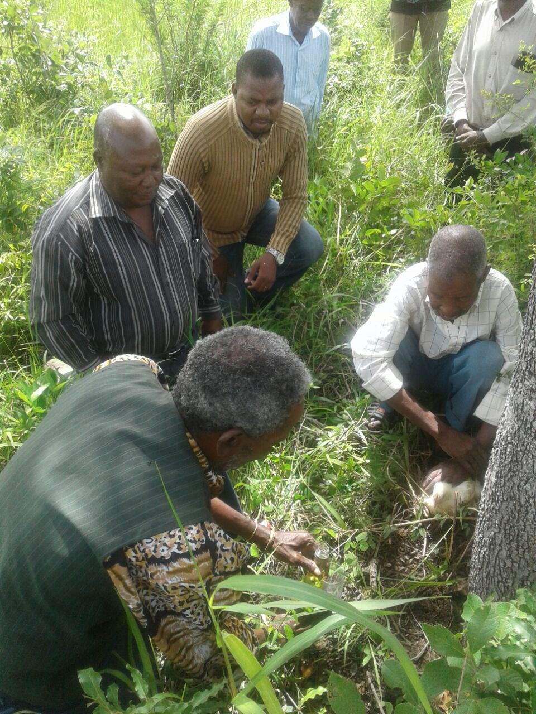
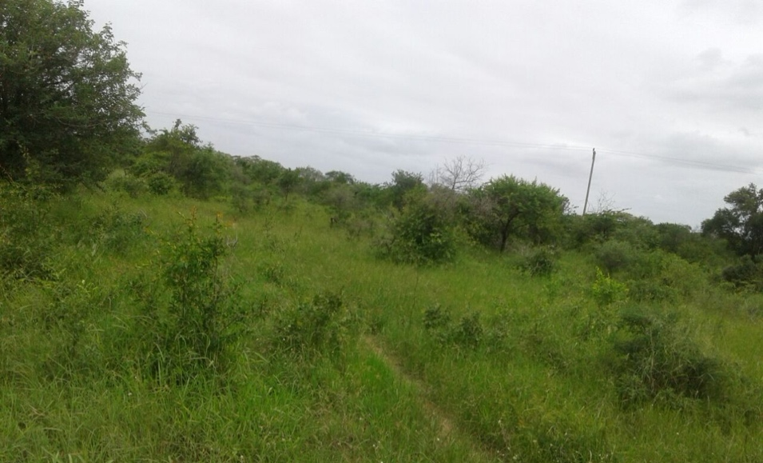
And blessed
Approved site at Majuva
Notes:
There was a traditional ceremony by the local traditional land chief or (Régulo Majuva) which was done in the presence of some members of the community and Diocesan representatives (Archdeacon Rogério and Fr. Sergio Bambo Diocesan Secretary) to authorize the Diocese to have and use the space for the Seminary.
The site intended for the new seminary at Majuva about 25 km from Catembe towards Ponta de Ouro. Government title deeds are in process.

Slide 10
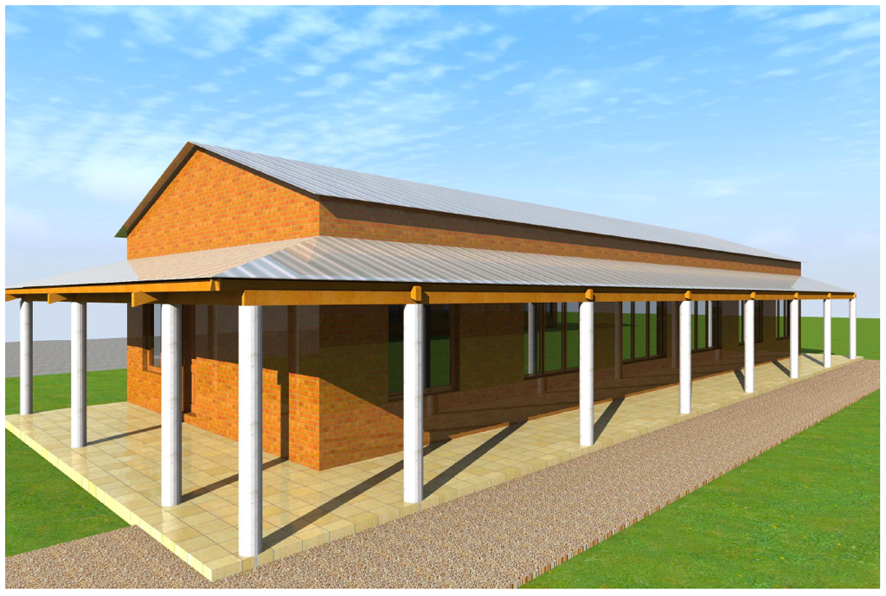
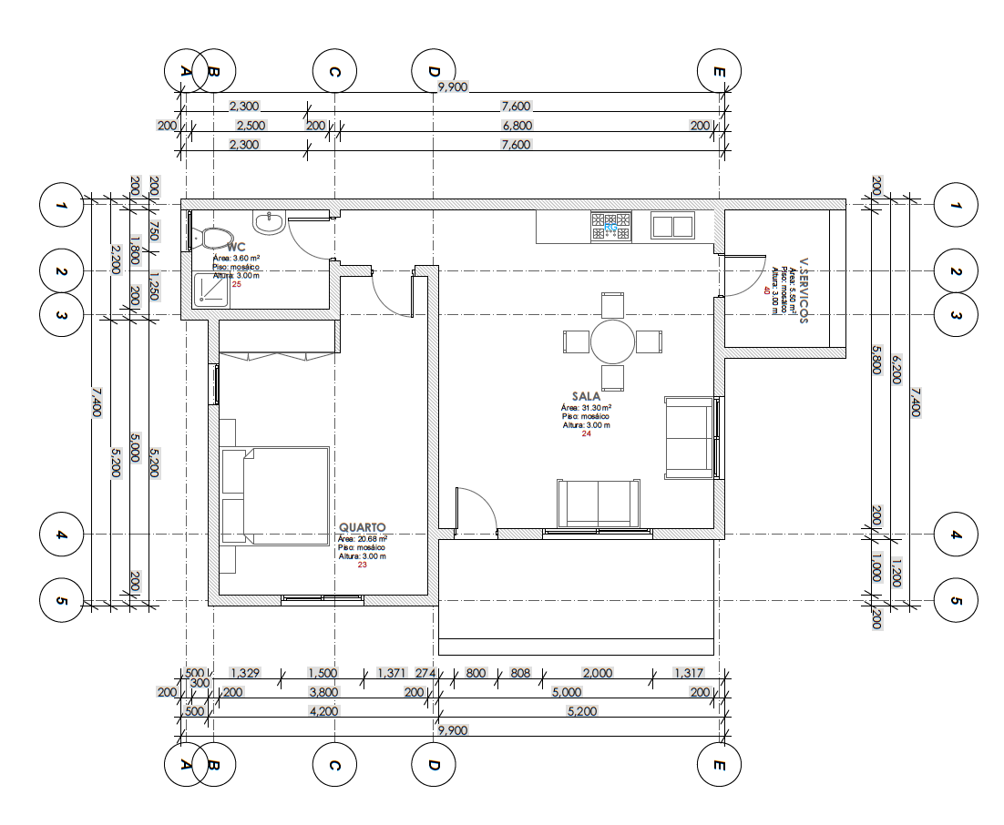
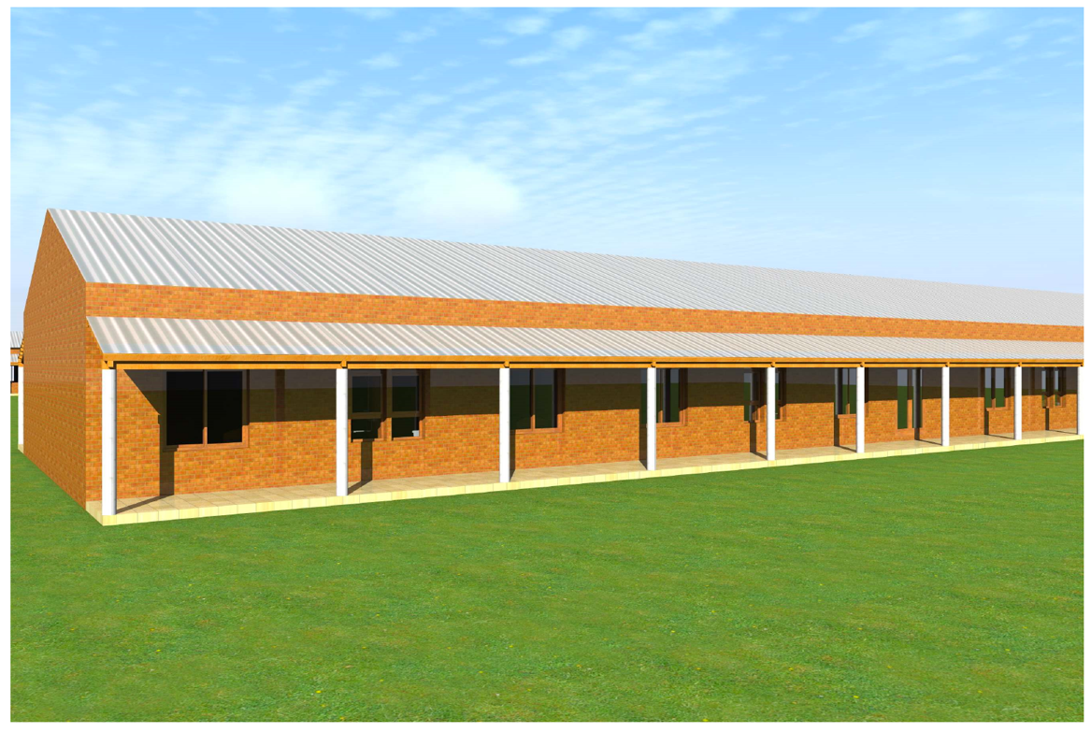
Plans by local architect
Library
Teaching accommodation
Dormitories
Classrooms
Refectory
Notes:
Plans have now been drawn up by a local architect. Facilities will include:
Library
Teaching accommodation
Dormitories
Classrooms
Refectory

Slide 11
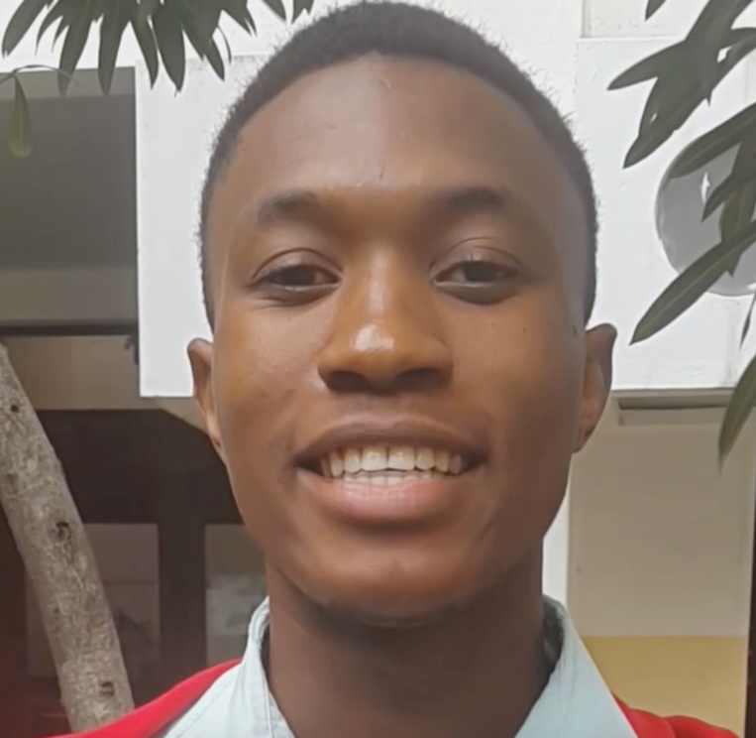
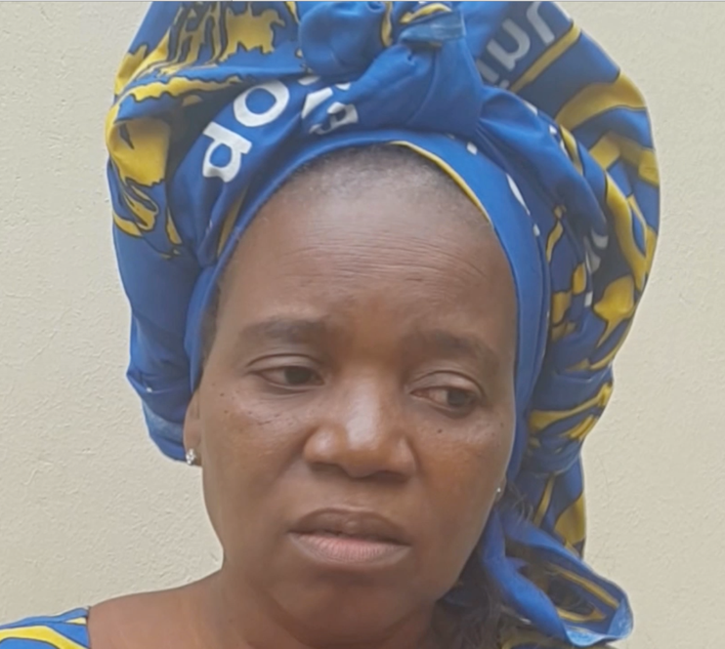
The new seminary will
make a huge difference
to many people including students like
2nd year seminary student
Edilson Esteira and
Joana Chilengue,
one of the two women
studying at the seminary
Notes:
The new seminary will make a huge difference to many people including students like 2nd year seminary student Edilson Esteira and Joana Chilengue, one of the two women studying at the seminary

Slide 12
Edilson Esteira
2nd year seminary student
Lives with his aunt
Disrupts the learning process
Looking forward to residing on site
Notes:
Edilson’s story
Edilson has to live with his aunt because there is not enough space in the current buildings
Many people have to live elsewhere and commute and this disrupts the learning process
He looks forward to being able to reside in one space and to having a games field to exercise between study

Slide 13
Joana Chilengue
One of the two women
studying at the seminary
Not enough space
Bad condition.
Multiple users cause distraction to studies
Notes:
Joana’s message
“It is important and urgent to have new buildings for the seminary. At the moment we don’t have enough space and it is in a bad condition. This building houses the Diocesan secretary, the parish, parish rooms, choirs who area always practicing as well as weddings and parties. This is all a great distraction from our studies. …

Slide 14
Joana Chilengue
One of the two women
studying at the seminary
Separate rooms for men and women
Houses for the teachers.
Theology and other activities - such as agriculture - to take back to churches.
.”
Notes:
… With a new Centre we would have enough rooms for both men and women separately as well as houses for the teachers. As seminarians we need to not just learn about theology but also other activities that we can take with us to the people we find at our churches. If we had a separate space we could also develop other activities such as agriculture.”

Slide 15
Please join us as we journey with our vibrant and optimistic partners in Christ during Lent 2017 and support them in
Sowing Seeds for Tomorrow
For more information visit
www.london.anglican.org/lentappeal
Notes:
Slide 15: Please support the 2017 Lent Appeal
on behalf of ALMA and our Diocesan Partners in Angola and Mozambique.

