Slide 1
Lent Appeal 2017
On behalf of ALMA
and our Diocesan Partners
in Angola and Mozambique
The Diocese of Niassa
Notes:
Lent Appeal 2017
On behalf of ALMA London and our Diocesan Partners in Angola and Mozambique

Slide 2
Sowing Seeds for Tomorrow

Slide 3
The Diocese of Niassa
is building a church training hub with accommodation in Nampula for the huge Lurio region.
Notes:
The Diocese of Niassa
Is building a church training hub with accommodation in Nampula for the huge Lurio region.

Slide 4
It will be used for training:
locally ordained priests,
lay leaders,
Mothers’ Union and
community development
fieldworkers & teams.
Notes:
It will be used for training
locally ordained priests,
lay leaders,
Mothers’ Union and
community development fieldworkers and teams.

Slide 5
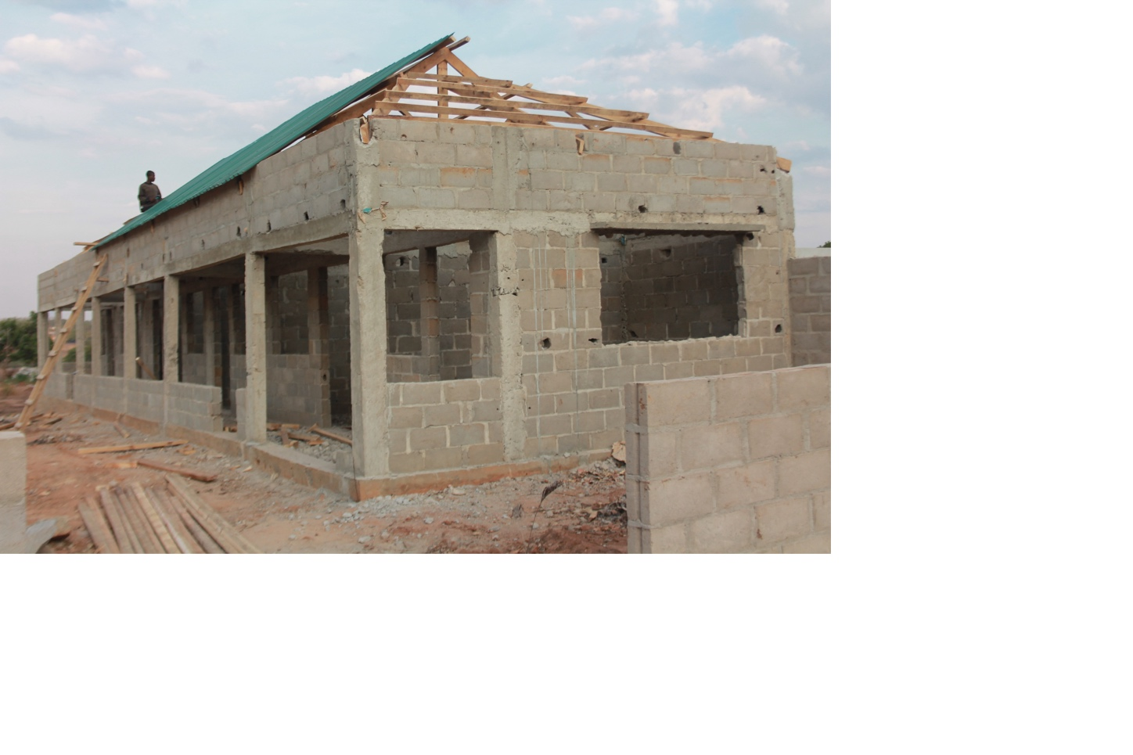
Construction has already begun!
Notes:
Construction on the meeting rooms has already begun using local funds.

Slide 6
Next phase:
Improved water supply
Protection wall
Female dormitory
Male dormitory
Notes:
The Diocese are now seeking support to upgrade the centre to include the following:
Improved water supply
Protection wall
Female dormitory
Male dormitory

Slide 7
A strategic location
Lurio:
Home for 9 million people - 20,000 Anglicans
Currently an episcopal area
Planned missionary diocese by 2017
with an administrative & spiritual centre
in Nampula
Notes:
A strategic location
Lurio – one of the six Archdeaconries within the Diocese of Niassa is:
Home for 9 million people and 20,000 Anglicans
Currently an episcopal area with plans for it to become a missionary diocese by 2017 with an administrative and spiritual centre in Nampula

Slide 8
A strategic location
Nampula
The principal town in Northern Mozambique
Easy connections to the Diocese of Lebombo
Notes:
Nampula
Is the principal town in Northern Mozambique
Has easy connections to the Diocese of Lebombo and the two Episcopal Areas of Niassa and Zambezia within the Diocese of Niassa
Direct flights to Johannesburg, Harare, Dar es Salaam, Nairobi and more recently to Antananarivo
All wayfarers from mainland Niassa, Northern region of Pemba and Maputo in the south change their buses in Nampula

Slide 9
For clergy training
Guest house for mission workers
Meeting point for Diocesan staff and volunteers
A multi-use space:
Notes:
A multi-use space
Which will provide:
For Clergy training
A guest house for mission workers
A meeting point for Diocesan staff and volunteers

Slide 10
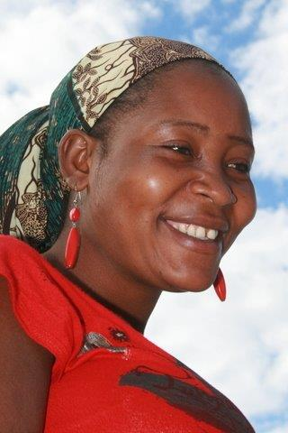
Muassite’s journey
For Muassite, the new church training hub will be a life changer. She lives in Cabo Delgado, but her role as mission work co-ordinator means she has to travel many miles to meet with colleagues
Notes:
Muassite’s journey
For Muassite, the new church training hub will be a life changer. She lives in Cabo Delgado, but her role as mission work co-ordinator means she regularly meets with her counterparts from other parts of the diocese to discuss strategy and consider diocesan-wide planning.
Without an office in Lurio, that region is rarely the meeting spot and she has to travel many miles to meet with colleagues.
When she travels to a four-day meeting in Lichinga, there will be three days of travel to get there.

Slide 11
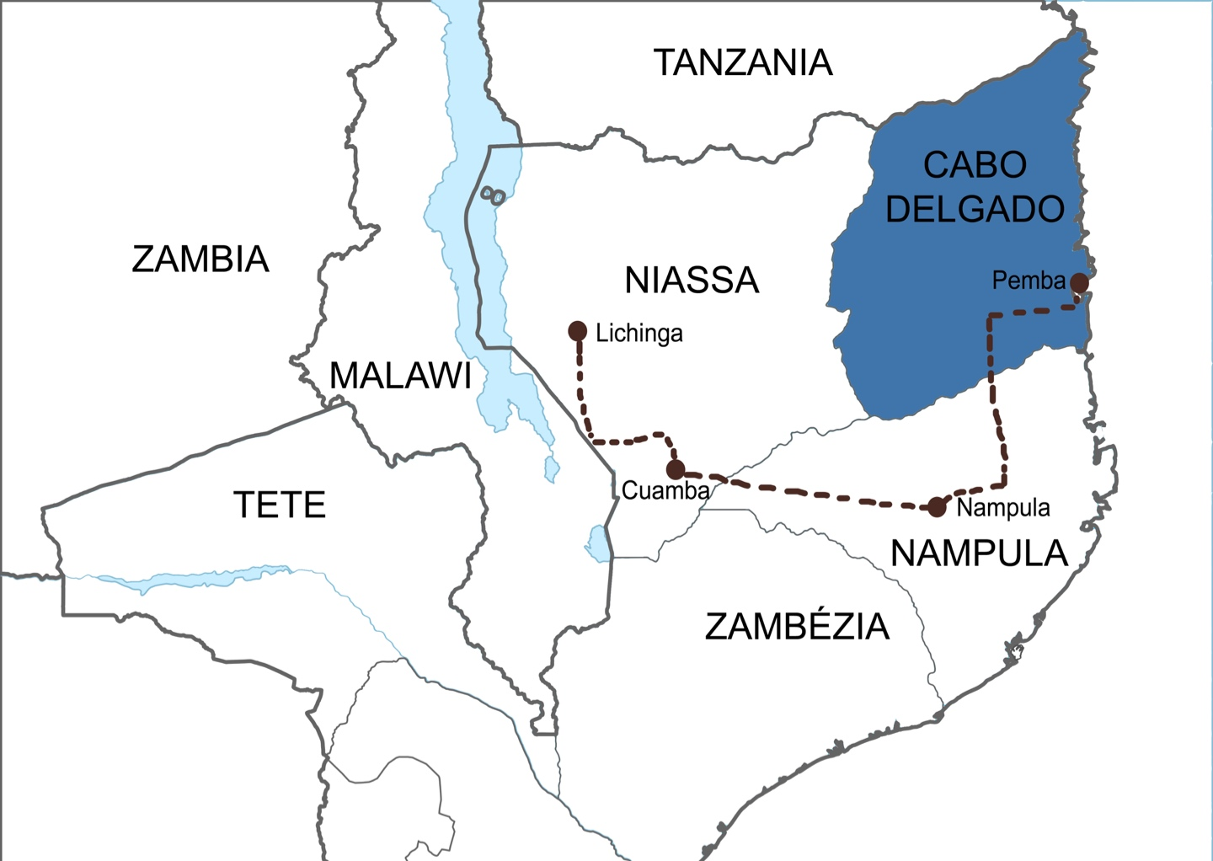
Muassite’s journey
Several hours of walking with luggage
2 long distance buses
12 hours on cramped minibuses
= 3 days of travel
Notes:
Muassite’s journey
Modes of travel include:
Several hours of walking
Usually in the early hours of the morning carrying her luggage
Leaving her children asleep in bed.
Two long distance bus journeys.
If Muassite has managed to buy a ticket on the previous day, she’ll have a seat,
If not, she’ll travel standing up.
Sometimes - maybe on 50% of the journeys - the bus breaks down. Because the road is so bad, the bus company sends the most beat-up buses, so that the new ones aren’t damaged.
Up to 12 hours squashed in on cramped minibuses.
Four people fill the seats designed to hold three
ALL luggage is carried on the passengers’ laps or by their feet.

Slide 12
Muassite’s journey
Muassite is often away from home for 10 days at a time and returns exhausted.
A new training hub in Nampula would save her all this travel.
Notes:
Muassite is often away from home for 10 days at a time and returns exhausted.
A new training hub in Nampula would save her all this.

Slide 13
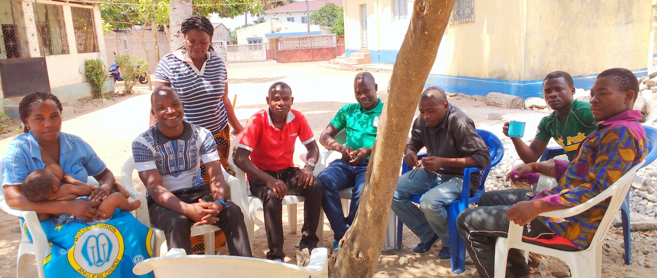
Rebecca Vander Meulen
Director of Mission
“Our brainstorming and story-telling work goes well whether we are under a mango tree, or on a boat, or sitting around a table…”
Notes:
Rebecca Vander Meulen, Director of Mission comments:
“Our brainstorming and story-telling work goes well whether we are under a mango tree, or on a boat, or sitting around a table…”

Slide 14
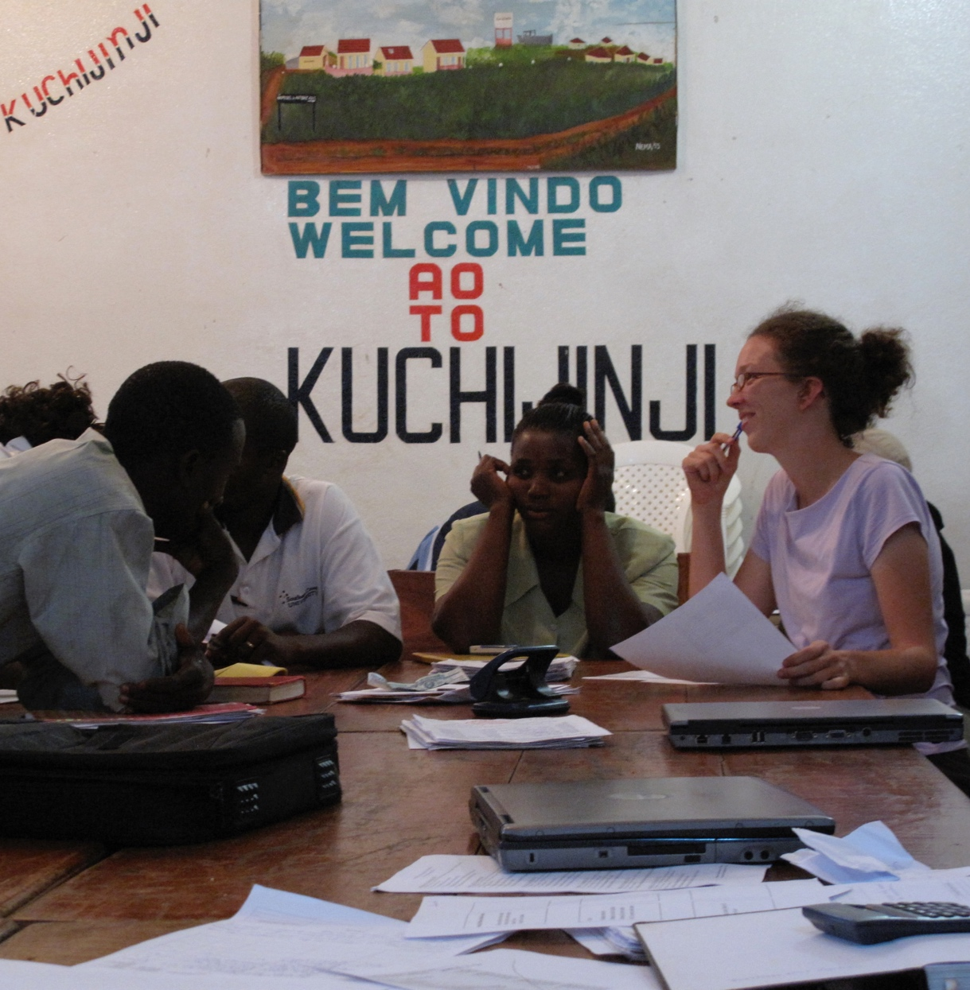
“…but it’s much easier to track budgets and define indicators and write reports where there are tables and chairs and electricity.
Notes:
“…but it’s much easier to track budgets and define indicators and write reports where there are tables and chairs and electricity.”

Slide 15
Please join us as we journey with our vibrant and optimistic partners in Christ during Lent 2017 and support them in
Sowing Seeds for Tomorrow
For more information visit
www.london.anglican.org/lentappeal
Notes:
Please support the 2017 Lent Appeal on behalf of ALMA and our Diocesan Partners in Angola and Mozambique.

